Slide 2
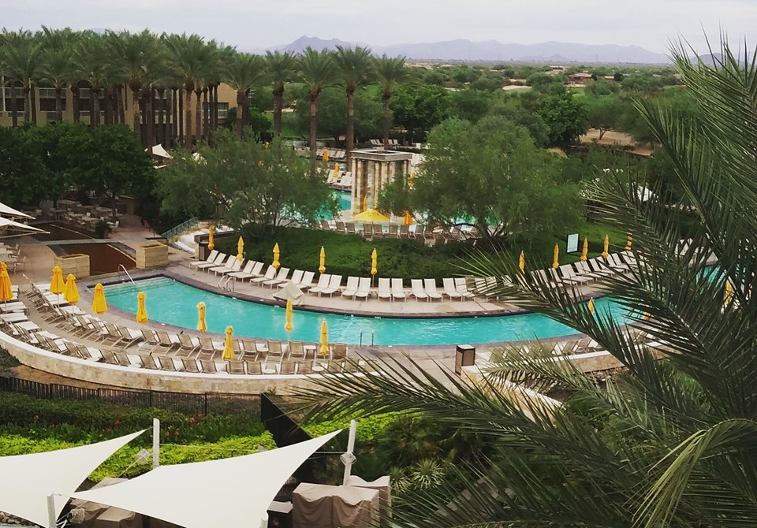
NFRW 38th Biennial Convention September 10-13th

Slide 3
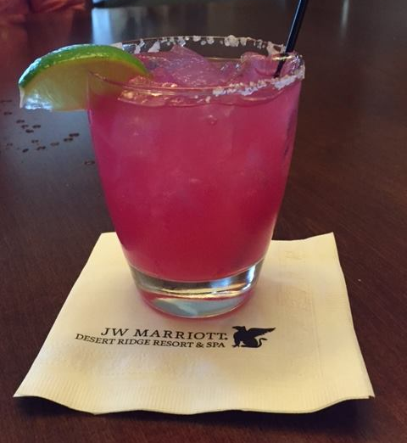
NFRW 38th Biennial Convention September 10-13th
The JW Marriott prepared a signature cocktail for the NFRW Convention - the Pink Elephant Prickly Pear Margarita. It was YUMMY!

Slide 4
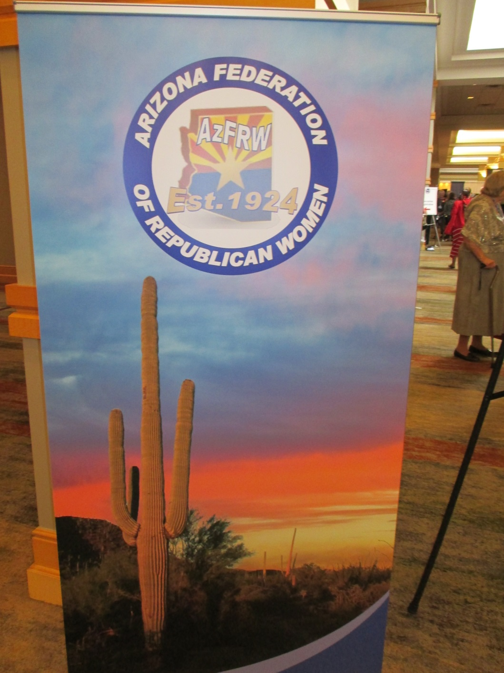
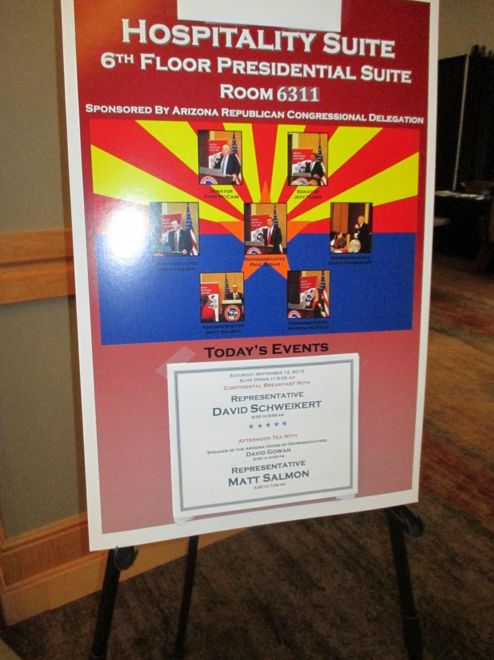
NFRW 38th Biennial Convention September 10-13th

Slide 5
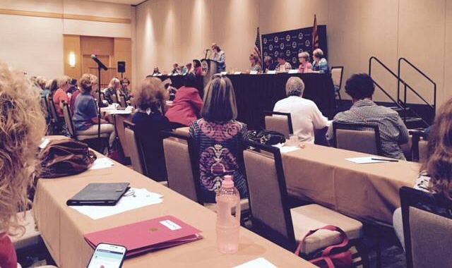
NFRW 38th Biennial Convention September 10-13th Board of Directors Meeting

Slide 6
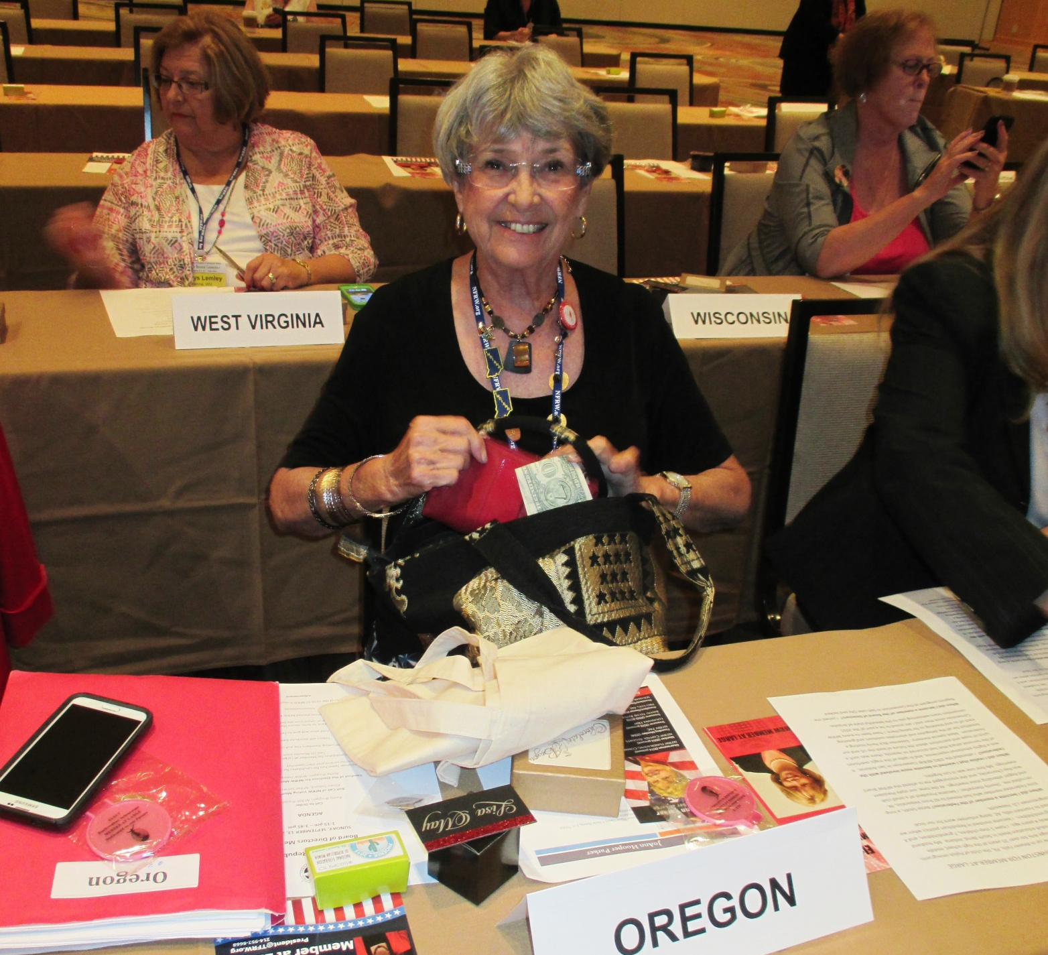
NFRW 38th Biennial Convention September 10-13th

Slide 7
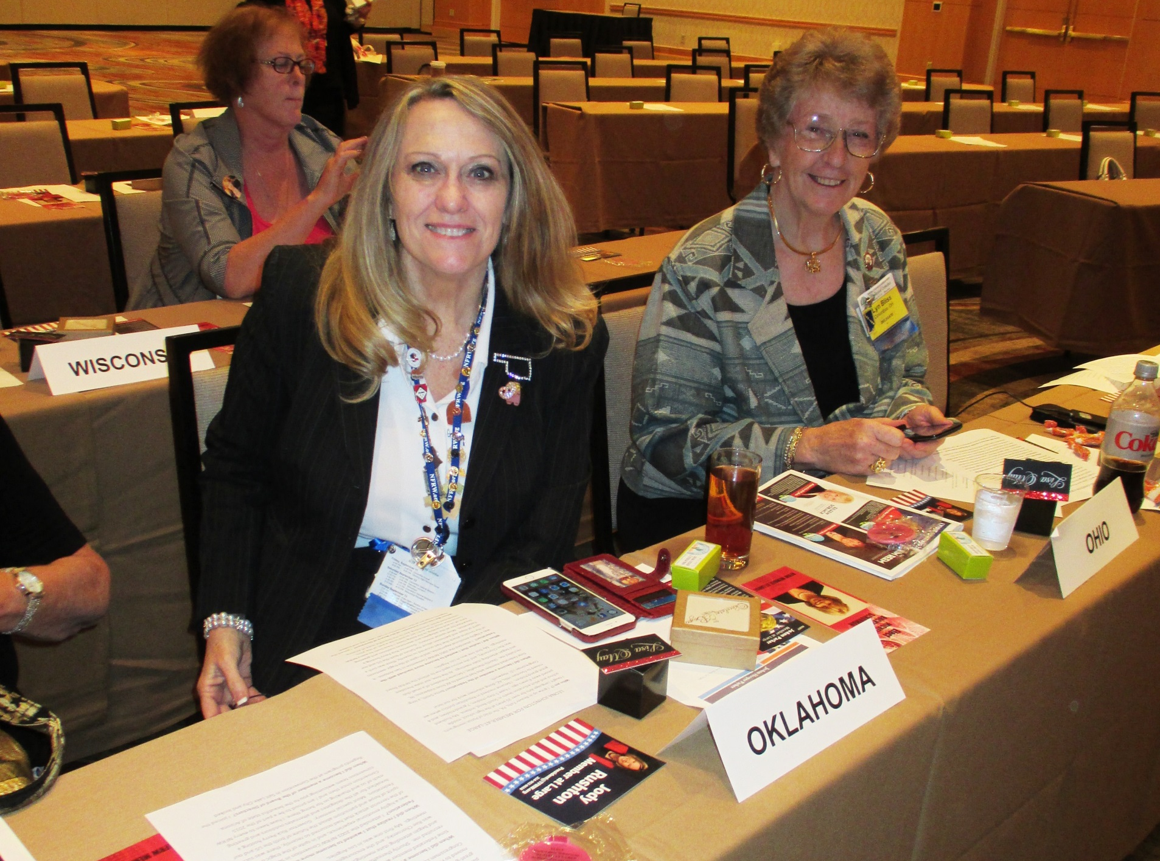
NFRW 38th Biennial Convention September 10-13th

Slide 8
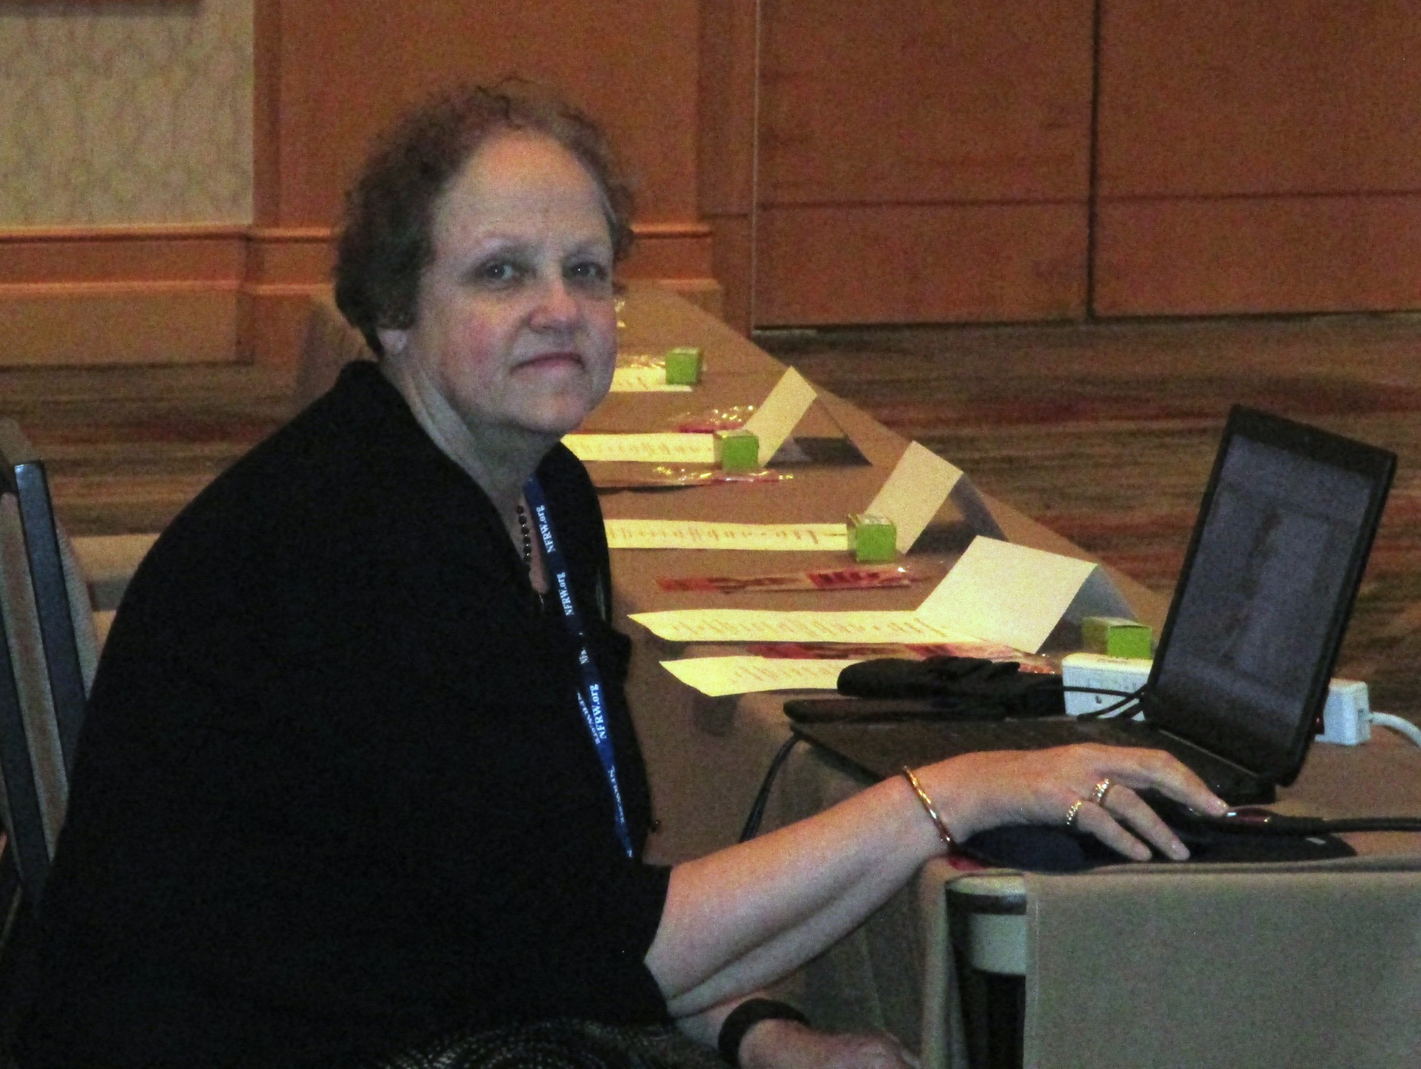
NFRW 38th Biennial Convention September 10-13th

Slide 9
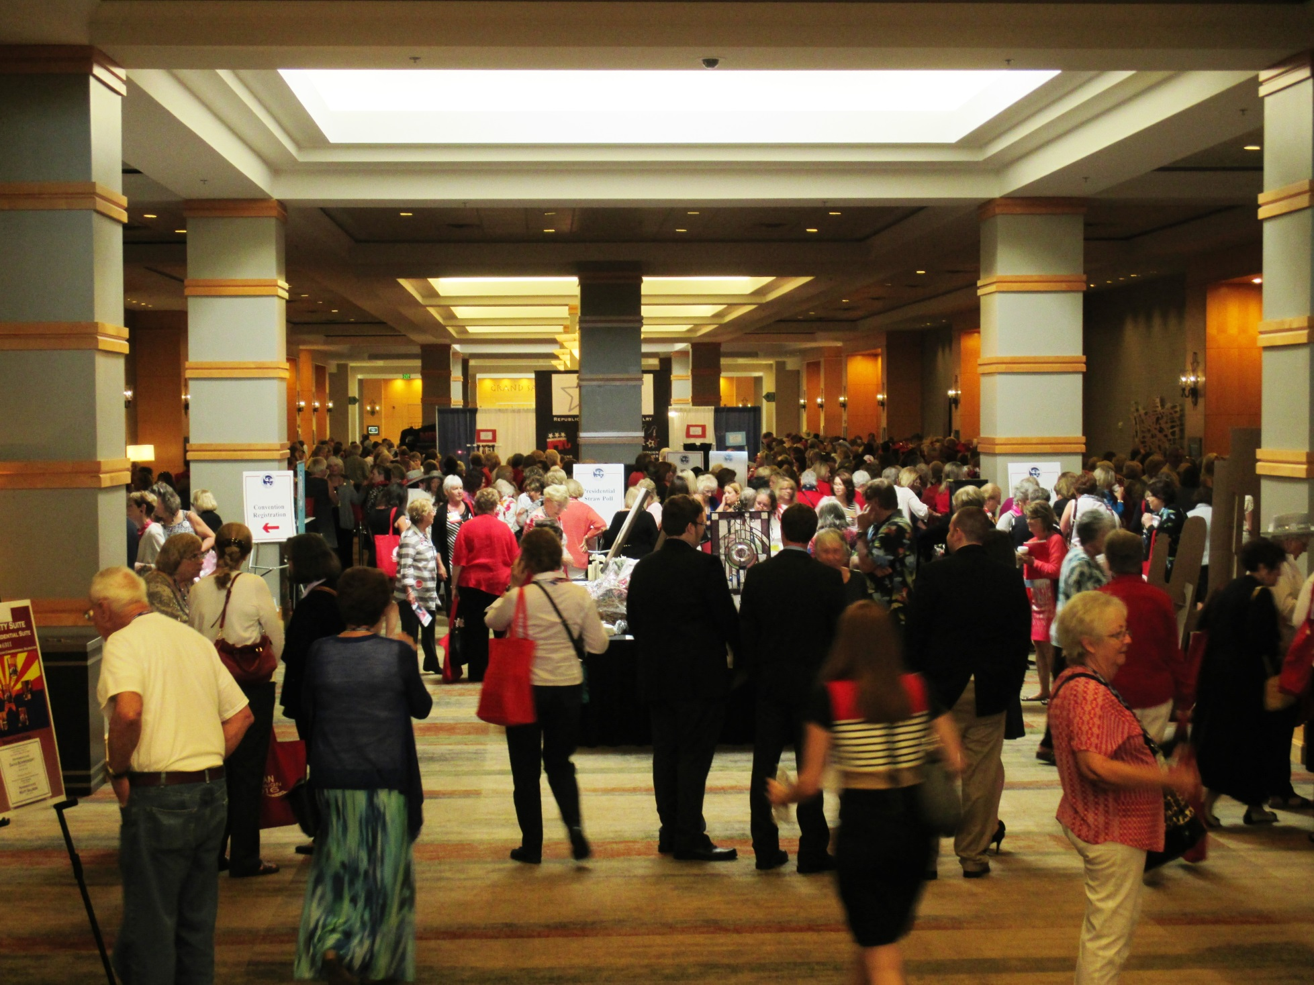
NFRW 38th Biennial Convention September 10-13th

Slide 10
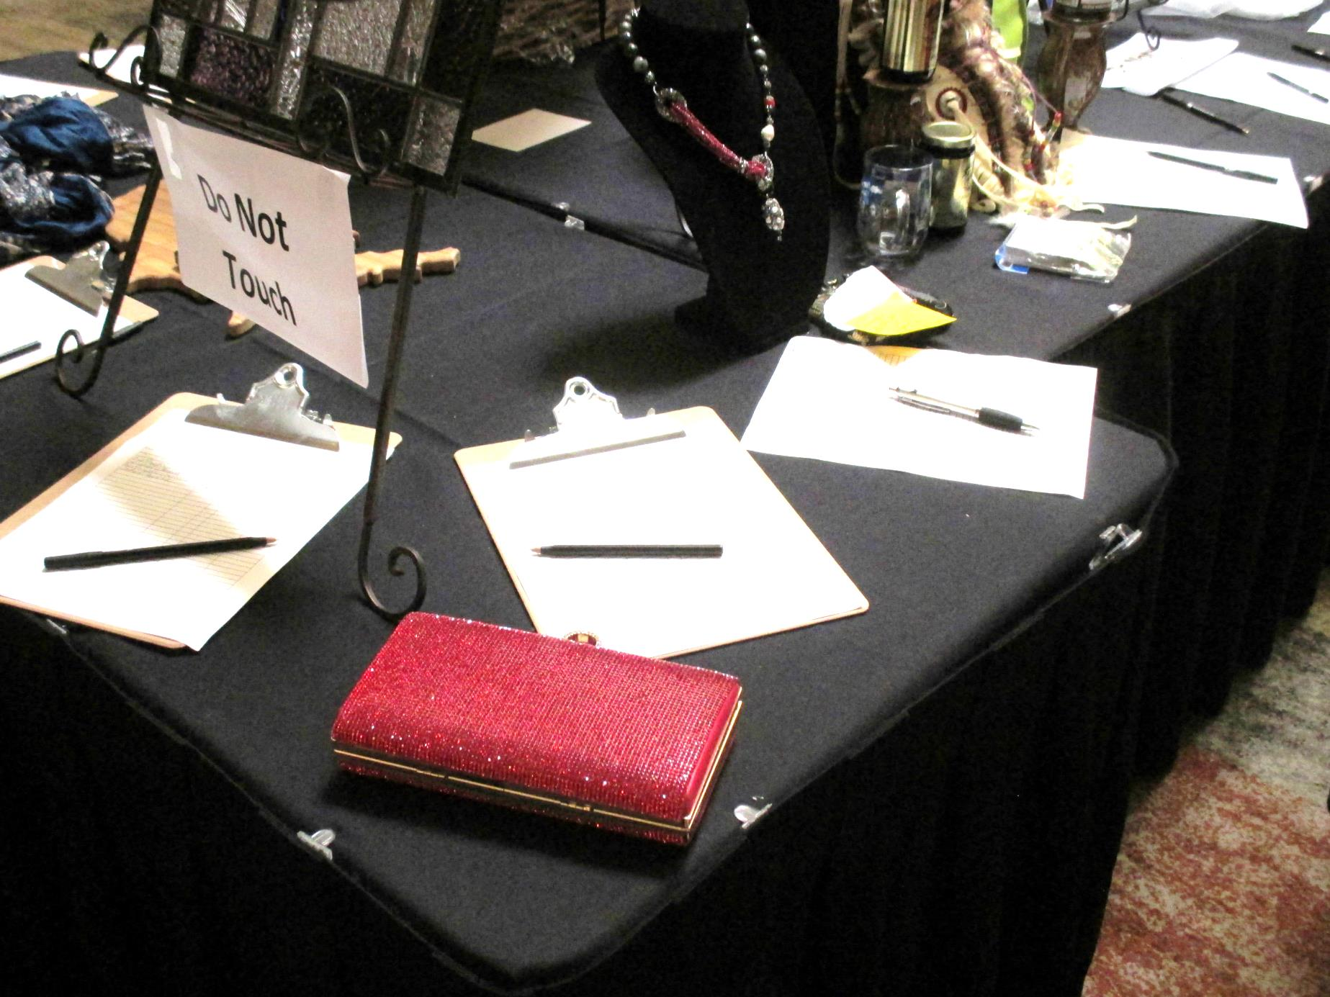
NFRW 38th Biennial Convention September 10-13th

Slide 11
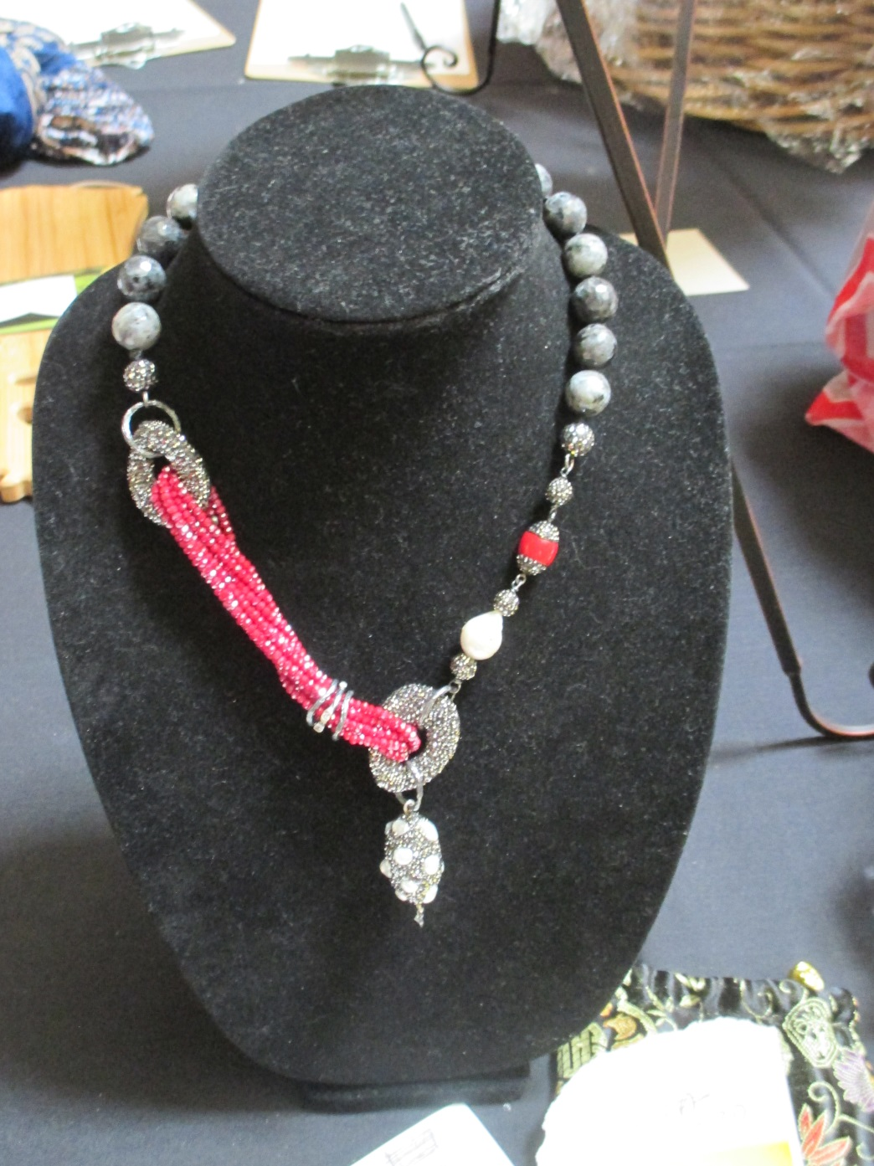
NFRW 38th Biennial Convention September 10-13th

Slide 12
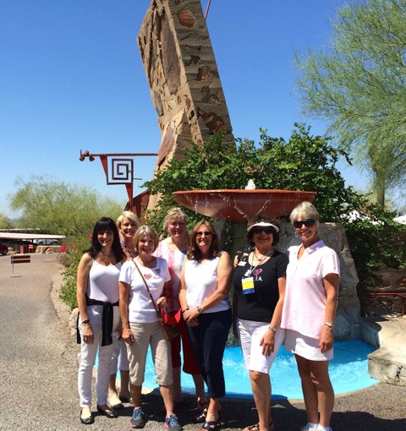
NFRW 38th Biennial Convention September 10-13th
Sightseeing at
TALIESIN WEST

Slide 13
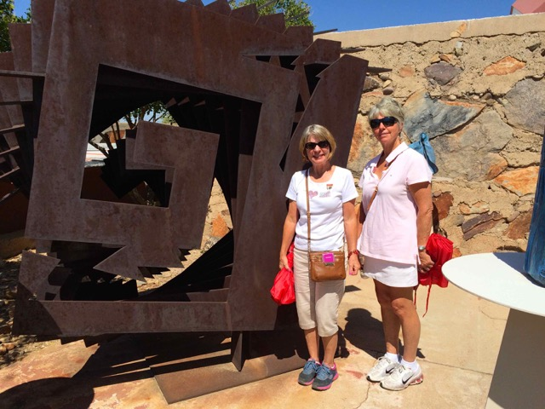
NFRW 38th Biennial Convention September 10-13th
Sightseeing at TALIESIN WEST

Slide 14
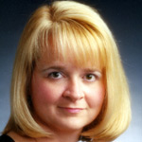
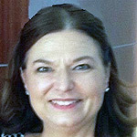
NFRW 38th Biennial Convention September 10-13th
Campaign Management Seminar Instructor:
Holly Robichaud; Political Consultant, Analyst and Instructor.
Leadership Training Seminar Instructor:
Nancy Bosckar; Author, Professor, Trainer and Consultant.

Slide 15
NFRW 38th Biennial Convention September 10-13th Friday Lunch Speaker was Christine Jones, Former Executive VP for GoDaddy.com and candidate for Arizona Governor

Slide 16
NFRW 38th Biennial Convention September 10-13th Nevada delegation was invited to meet Senator Ted Cruz’ wife, Heidi

Slide 17
NFRW 38th Biennial Convention September 10-13th Nevada delegation was invited to meet Senator Ted Cruz’ wife, Heidi

Slide 18
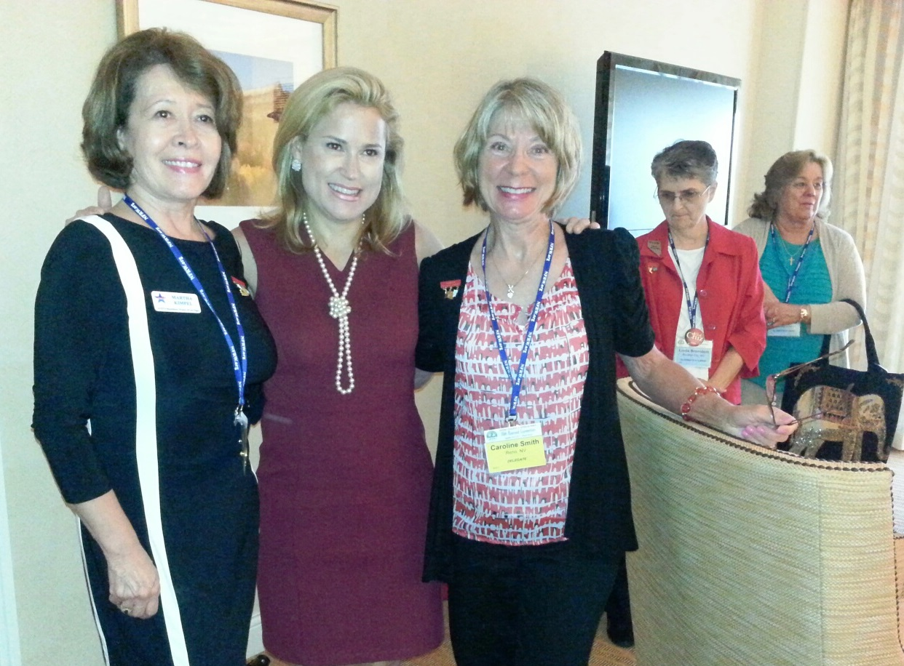
NFRW 38th Biennial Convention September 10-13th Nevada delegation was invited to meet Senator Ted Cruz’ wife, Heidi

Slide 19
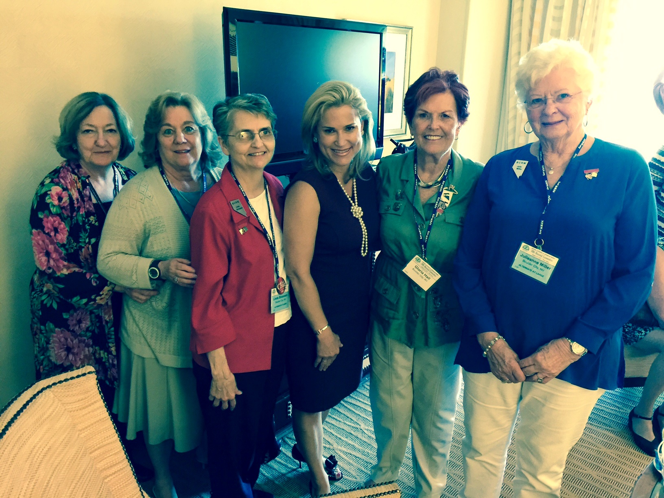
NFRW 38th Biennial Convention September 10-13th Nevada delegation was invited to meet Senator Ted Cruz’ wife, Heidi

Slide 20
NFRW 38th Biennial Convention September 10-13th Nevada delegation was invited to meet Senator Ted Cruz’ wife, Heidi

Slide 21
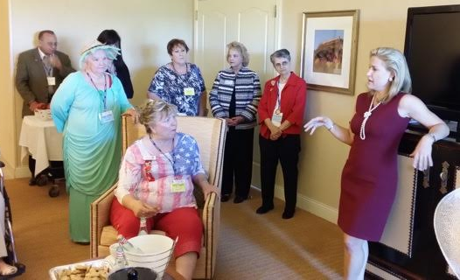
NFRW 38th Biennial Convention September 10-13th Nevada delegation was invited to meet Senator Ted Cruz’ wife, Heidi

Slide 22
NFRW 38th Biennial Convention September 10-13th Nevada’s Club President’s were invited to the Achievement Awards Ceremony. Nevada received thirteen awards.
Nevada Diamond Awards
Boulder City Republican Women
Carson City Republican Women
Douglas County Republican Women
Fernley Republican Women
Incline Village/Crystal Bay Republican Women
Southern Hills Republican Women

Slide 23
NFRW 38th Biennial Convention September 10-13th Nevada’s Club President’s were invited to the Achievement Awards Ceremony. Nevada received thirteen awards.
Nevada Gold Awards
Active Republican Women
Mesquite Republican Women
Republican Women of Reno
Sierra Nevada Republican Women
Sparks Republican Women
Nevada Silver Awards
Republican Women of Las Vegas
Nevada Bronze Awards
Washoe Republican Women

Slide 24
NFRW 38th Biennial Convention September 10-13th Nevada’s Club President’s were invited to the Achievement Awards Ceremony. Nevada received thirteen awards.

Slide 25
NFRW 38th Biennial Convention September 10-13th Carly Fiorina Republican candidate, U.S. President
"Ladies, look at this face. This is the face of a 61-year-old woman. I am proud of every year and every wrinkle."
NFRW President Kathy Brugger introduces Carly Fiorina

Slide 26
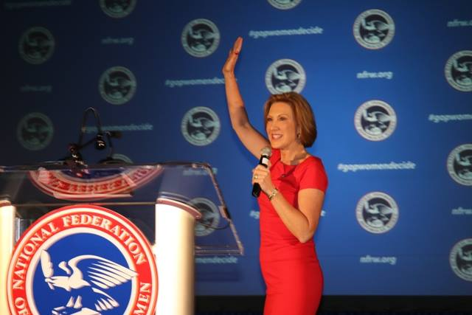
NFRW 38th Biennial Convention September 10-13th Carly Fiorina Republican candidate, U.S. President

Slide 27
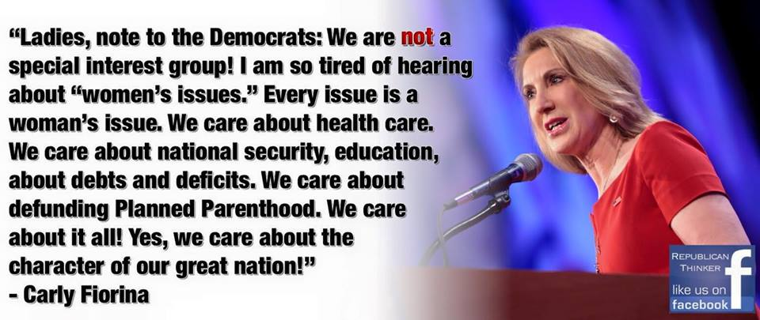
NFRW 38th Biennial Convention September 10-13th Carly Fiorina Republican candidate, U.S. President

Slide 28
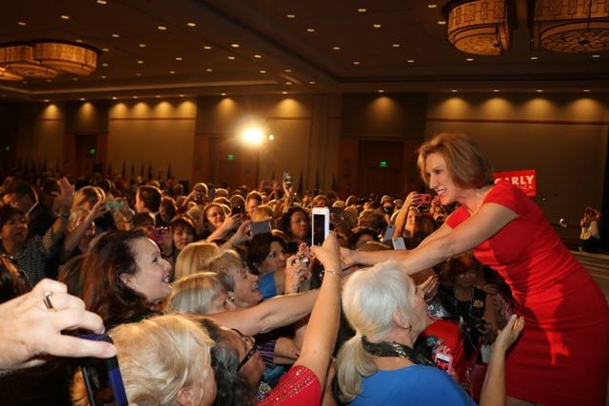
NFRW 38th Biennial Convention September 10-13th Carly Fiorina Republican candidate, U.S. President

Slide 29
NFRW 38th Biennial Convention September 10-13th
Roseann Slonsky-Breault, President of the California Federation, presented a beautiful 9-11 Remembrance

Slide 30
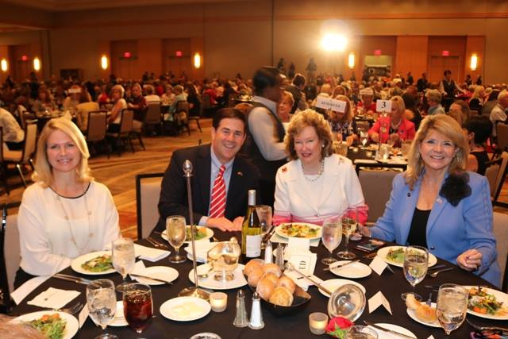
NFRW 38th Biennial Convention September 10-13th
Angela Ducey, First Lady of Arizona: The Honorable Doug Ducey, Governor of Arizona; Kathy Brugger, President of the NFRW and Sharon Day, RNC Vice Chair

Slide 31
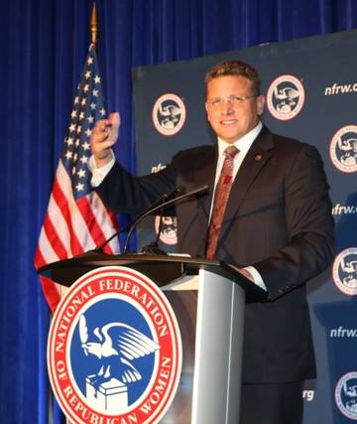
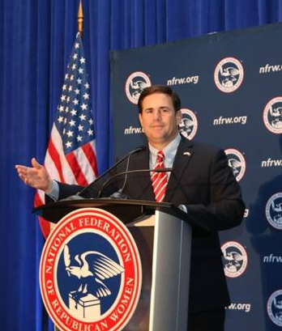
NFRW 38th Biennial Convention September 10-13th
Robert Graham, Chairman of the Arizona Republican Party
The Honorable Doug Ducey, Governor of Arizona

Slide 32
NFRW 38th Biennial Convention September 10-13th

Slide 33
NFRW 38th Biennial Convention September 10-13th Betty Heitman Awards for State Excellence
The Betty Heitman Awards for State Excellence are presented to states that demonstrate excellence, achievement or accomplishment in community relations, programs, campaign activities and state functions.
Excellence Awards were given to Arizona, California, New Jersey, Oklahoma and Texas.
Achievement Awards were given to Colorado, Idaho, South Dakota, Virginia and Washington
Accomplishment Awards were given to Alabama, Arkansas, Georgia, Illinois, Kansas, Kentucky, Louisiana, Mississippi, Nevada, North Carolina, Oregon, Tennessee and West Virginia.

Slide 34
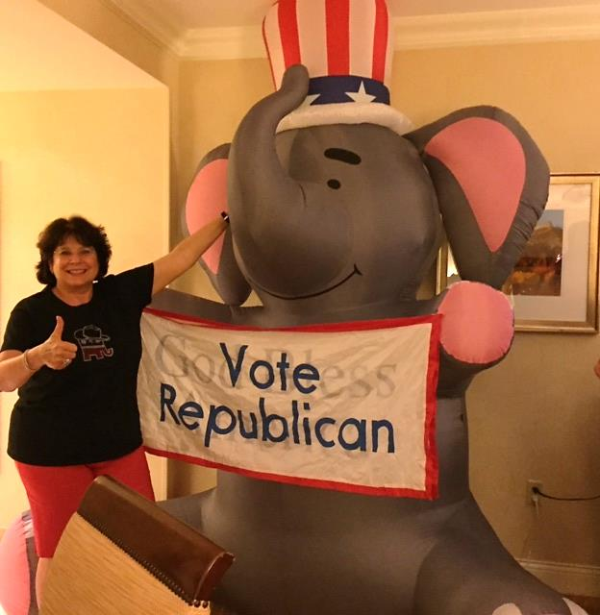
NFRW 38th Biennial Convention September 10-13th

Slide 35
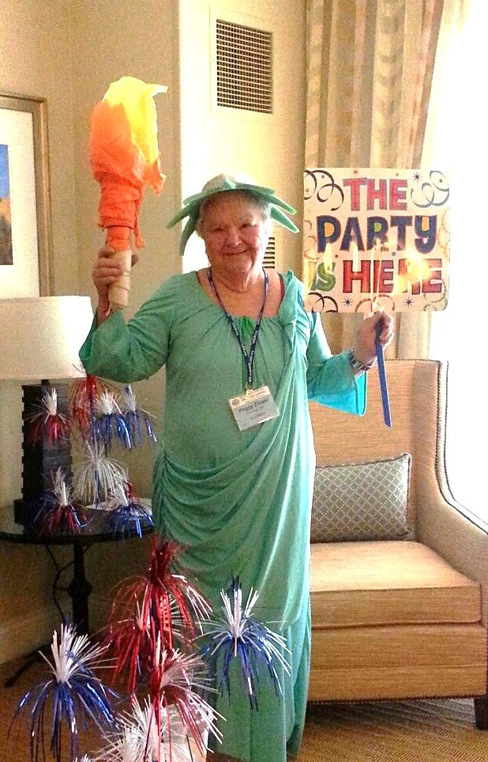
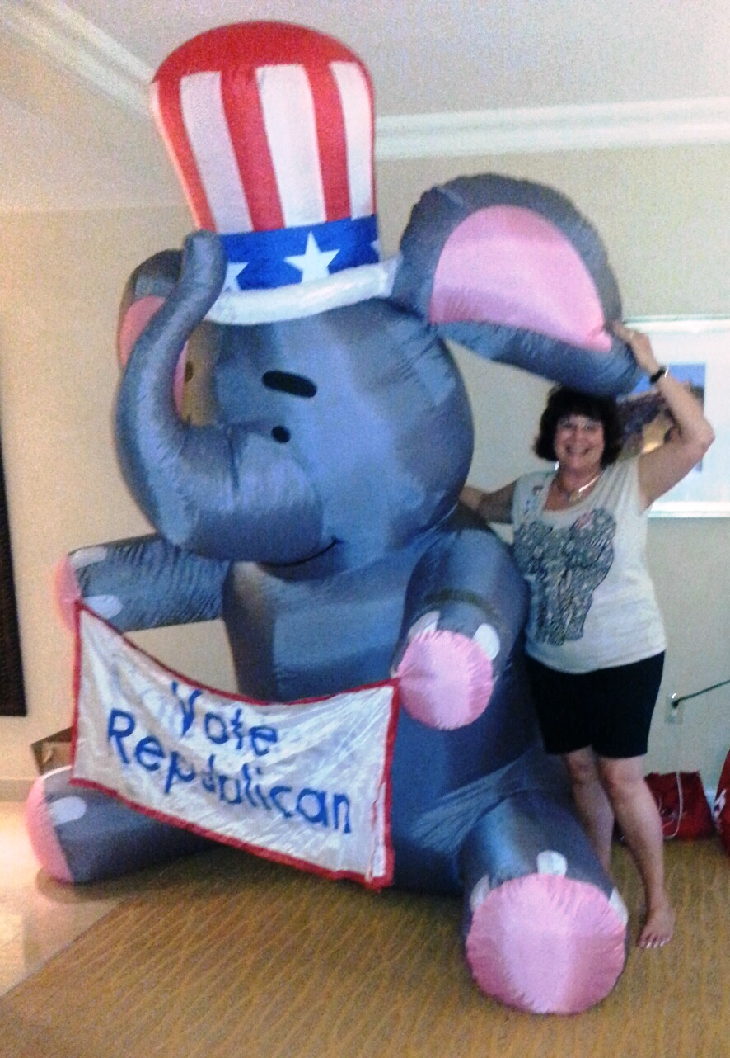
NFRW 38th Biennial Convention September 10-13th

Slide 36
NFRW 38th Biennial Convention September 10-13th
Our Mascot

Slide 37
NFRW 38th Biennial Convention September 10-13th

Slide 38
NFRW 38th Biennial Convention September 10-13th

Slide 39
NFRW 38th Biennial Convention September 10-13th

Slide 40
NFRW 38th Biennial Convention September 10-13th
Carol Del Carlo, President - Nevada Federation of Republican Women
Our fearless leader!

Slide 41
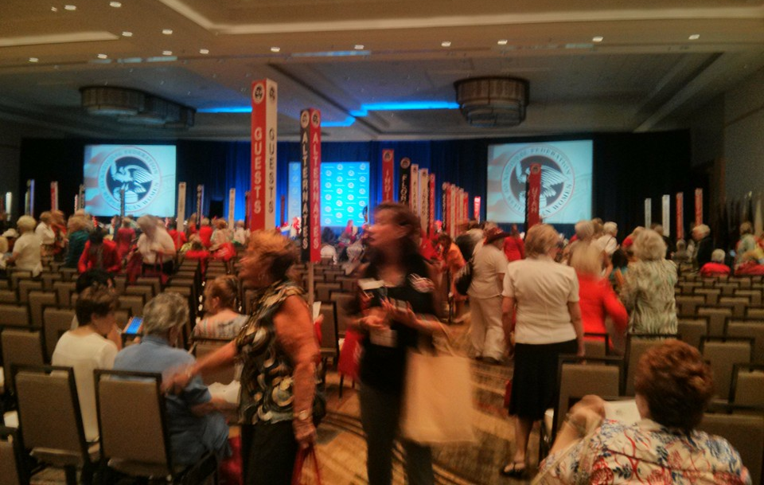
NFRW 38th Biennial Convention September 10-13th

Slide 42
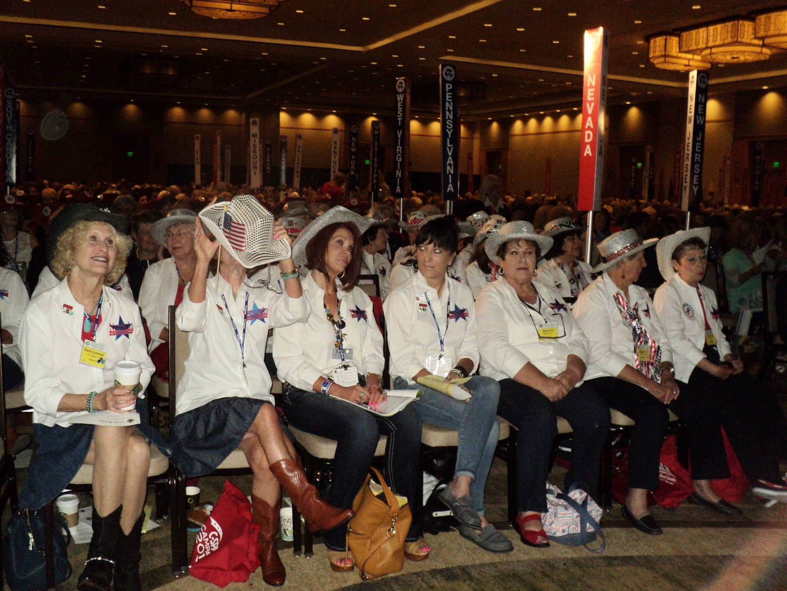
NFRW 38th Biennial Convention September 10-13th

Slide 43
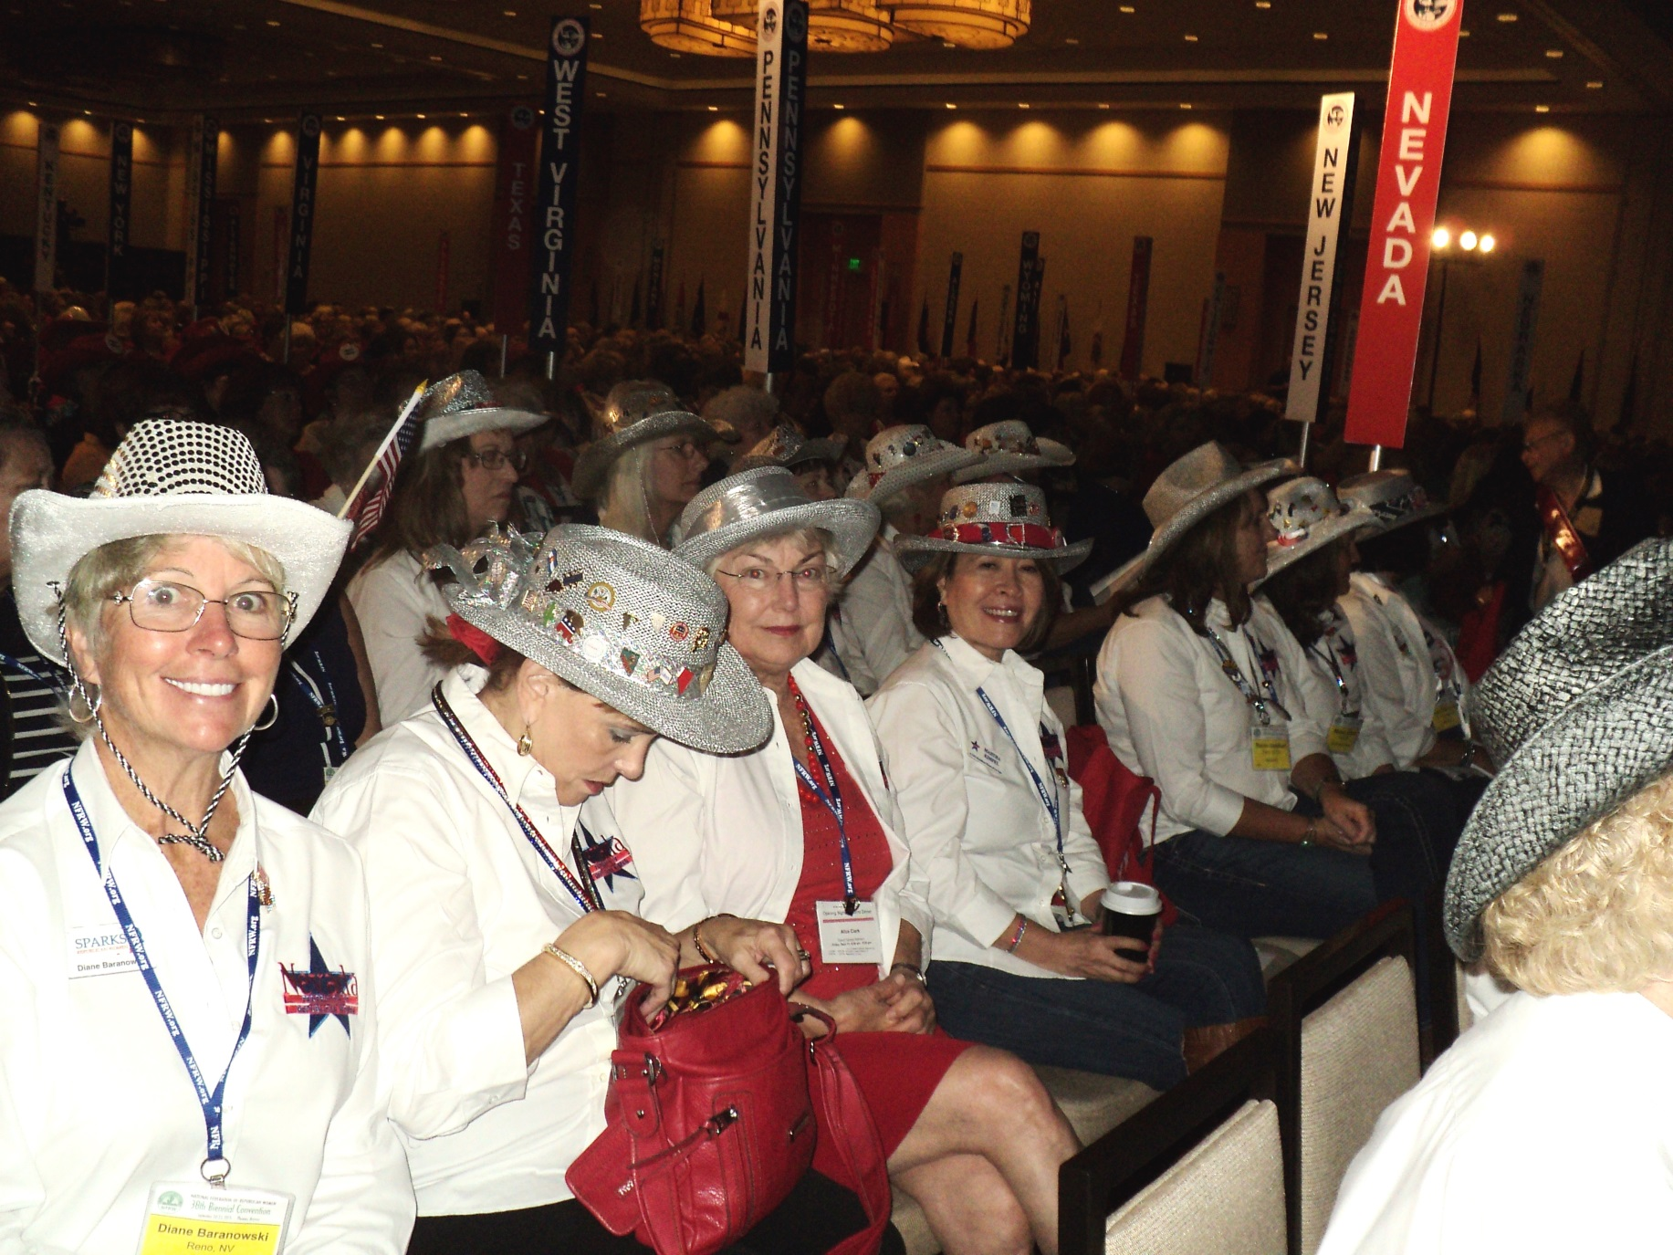
NFRW 38th Biennial Convention September 10-13th

Slide 44
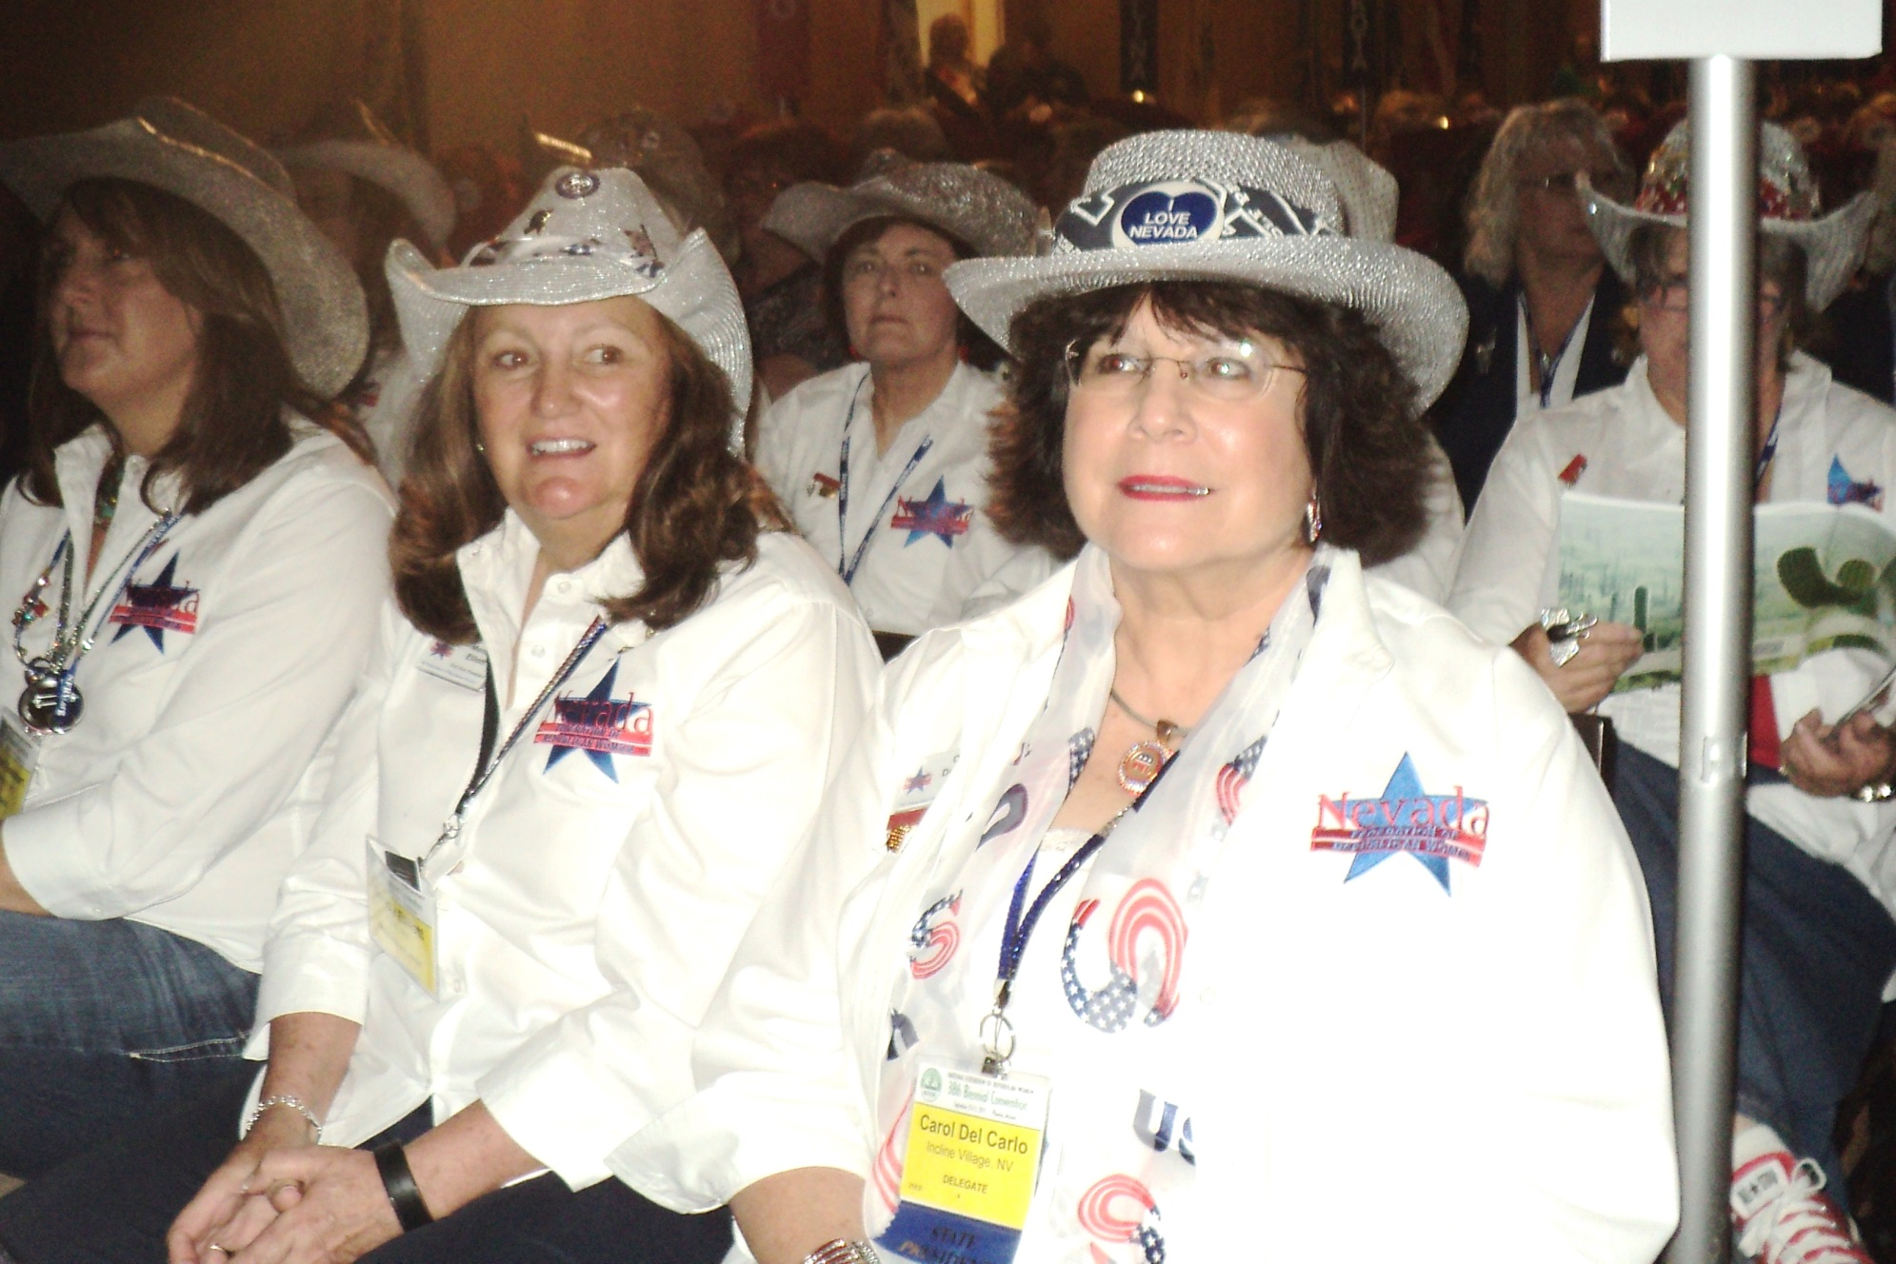
NFRW 38th Biennial Convention September 10-13th

Slide 45
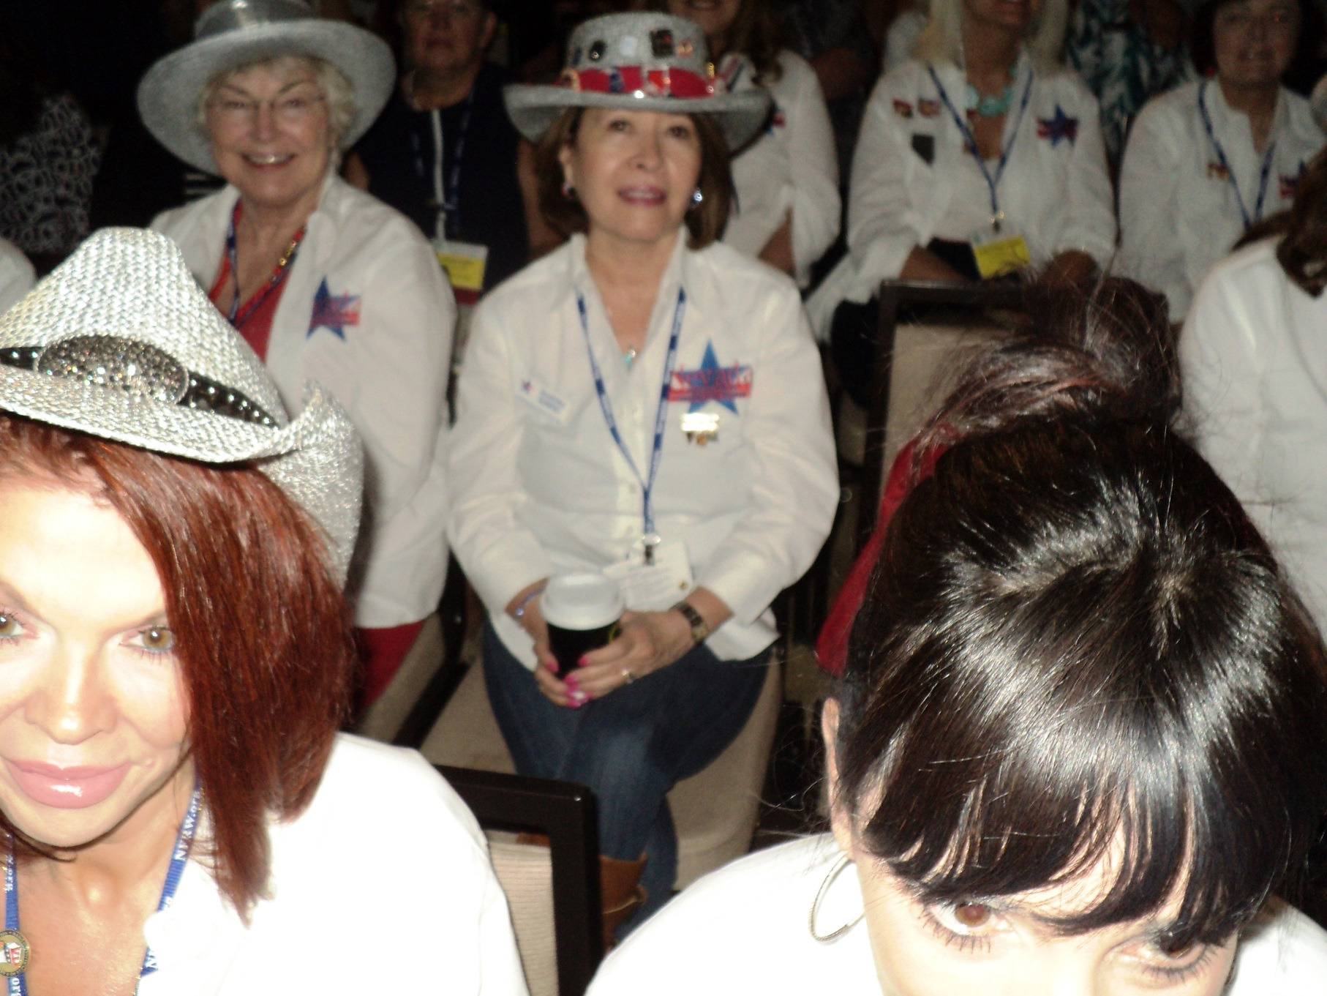
NFRW 38th Biennial Convention September 10-13th

Slide 46
NFRW 38th Biennial Convention September 10-13th

Slide 47
NFRW 38th Biennial Convention September 10-13th

Slide 48
NFRW 38th Biennial Convention September 10-13th

Slide 49
NFRW 38th Biennial Convention September 10-13th

Slide 50
NFRW 38th Biennial Convention September 10-13th

Slide 51
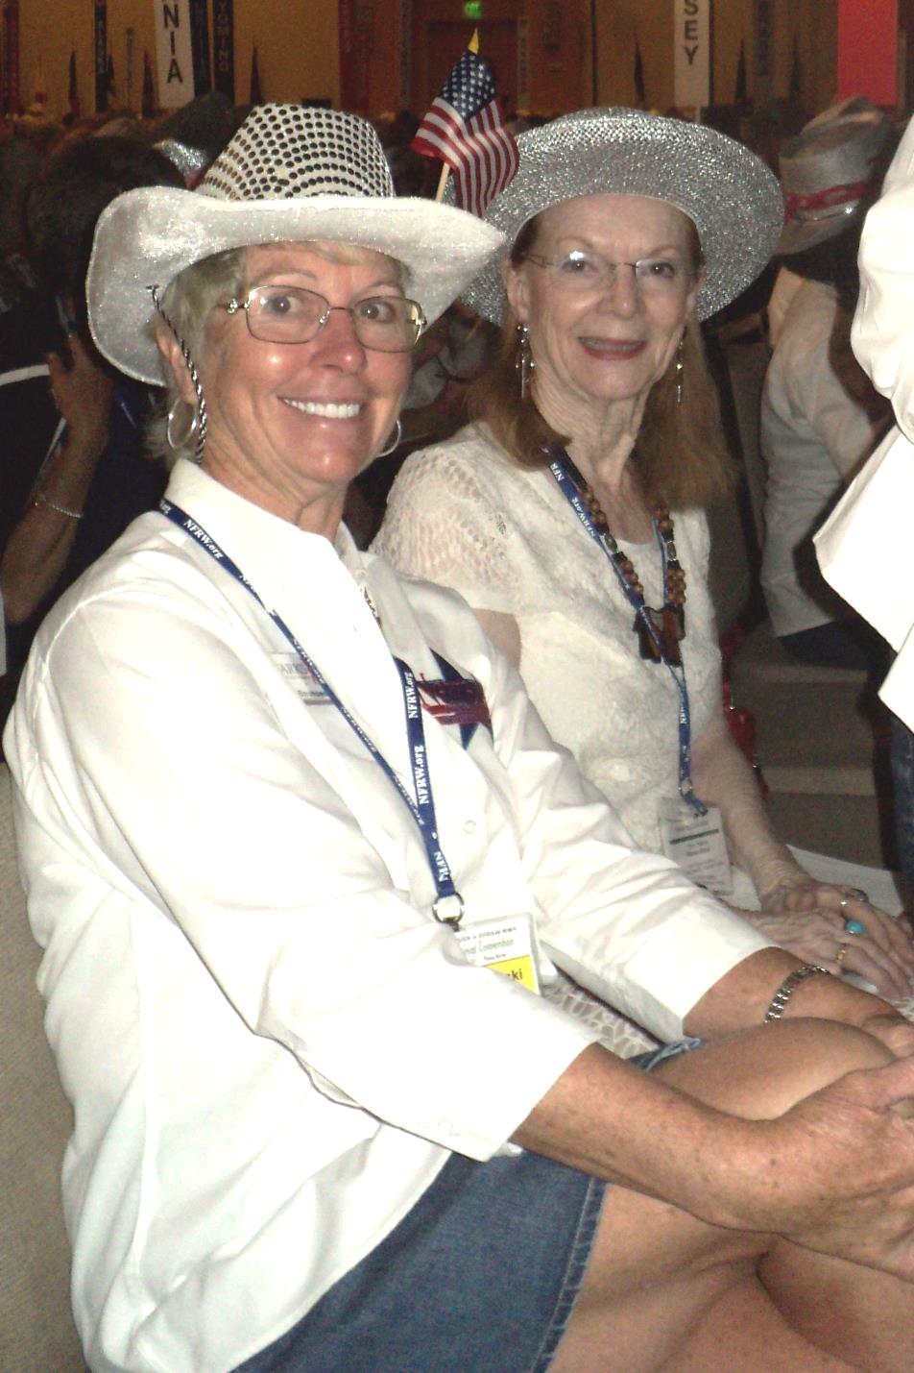
NFRW 38th Biennial Convention September 10-13th

Slide 52
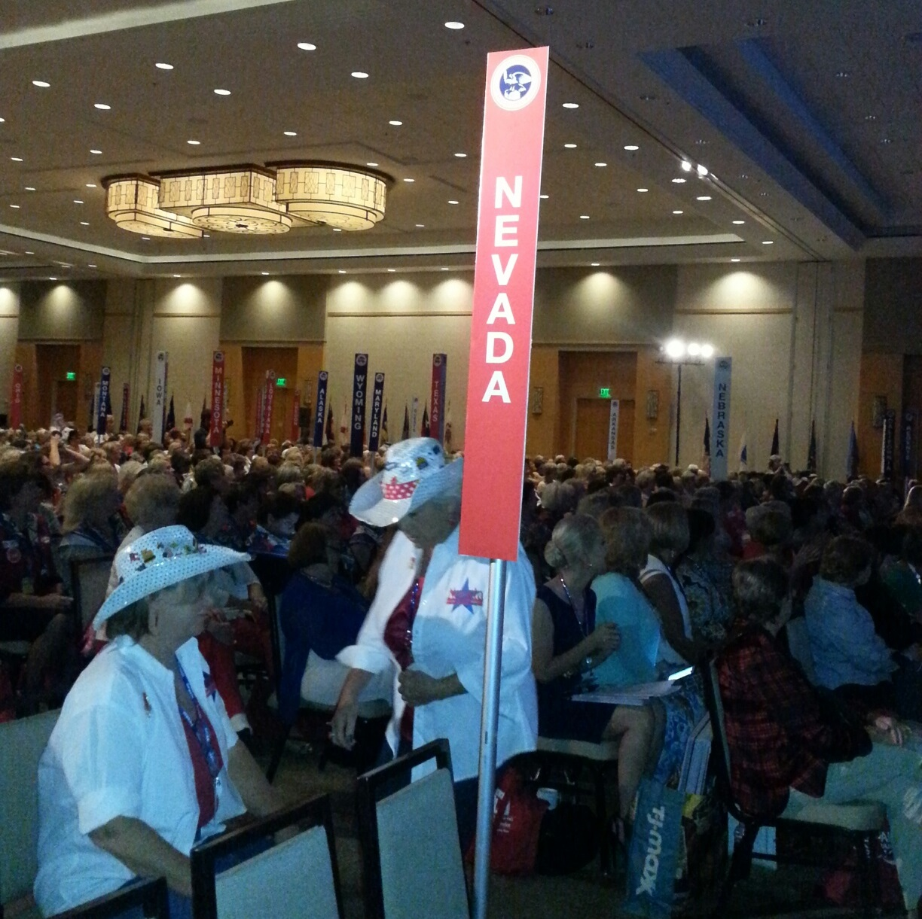
NFRW 38th Biennial Convention September 10-13th

Slide 53
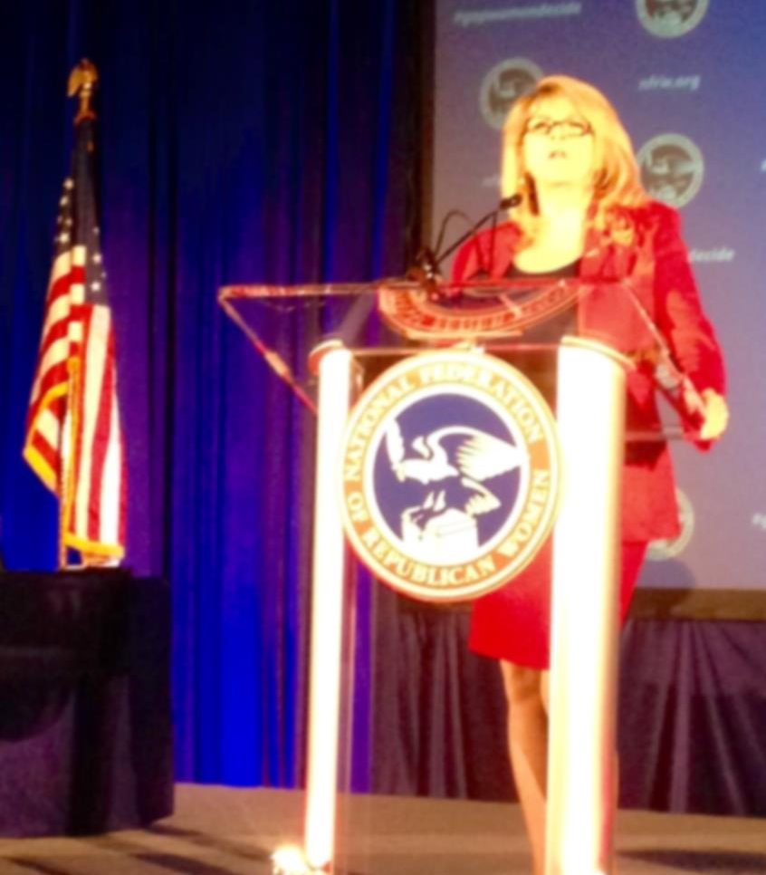
NFRW 38th Biennial Convention September 10-13th RNC Vice Chair Sharon Day

Slide 54
NFRW 38th Biennial Convention September 10-13th Nevada Delegates with RNC Vice Chair Sharon Day

Slide 55
NFRW 38th Biennial Convention September 10-13th

Slide 56
NFRW 38th Biennial Convention September 10-13th

Slide 57
NFRW 38th Biennial Convention September 10-13th

Slide 58
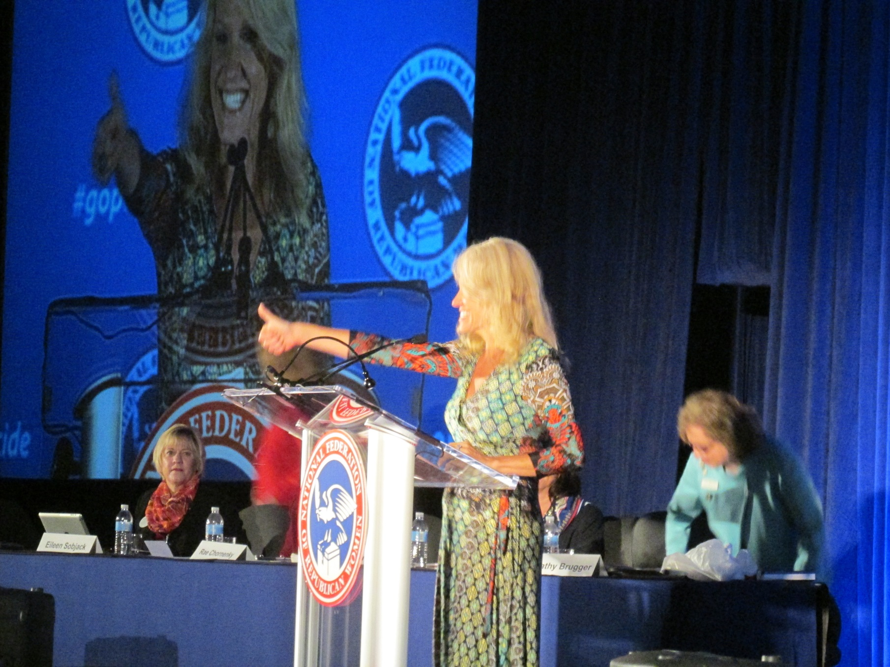
NFRW 38th Biennial Convention September 10-13th Kellyanne Conway, President and CEO, the polling coming, inc./Woman Trend – Addresses the convention and introduces the poll

Slide 59
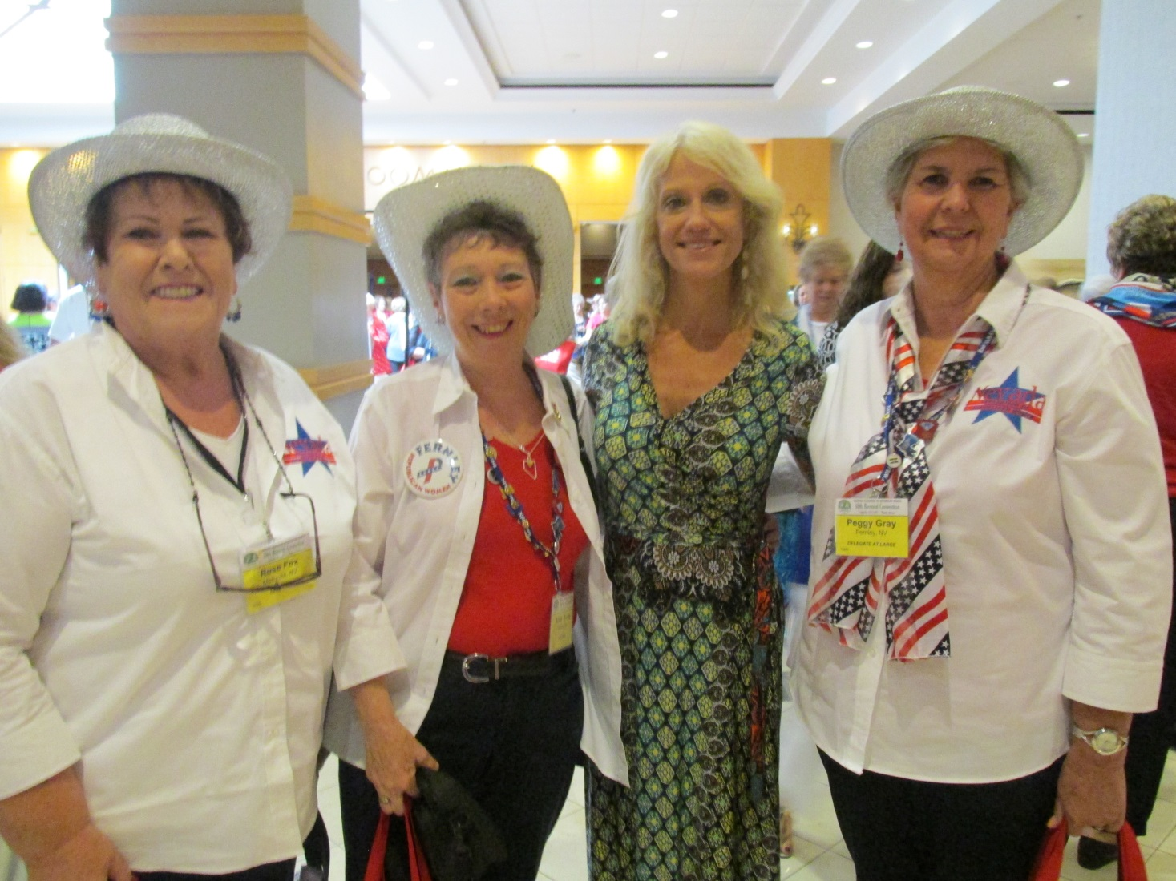
NFRW 38th Biennial Convention September 10-13th

Slide 60
NFRW 38th Biennial Convention September 10-13th

Slide 61
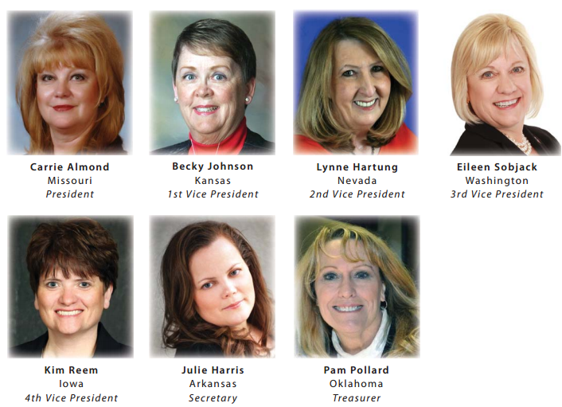
NFRW 38th Biennial Convention September 10-13th There were no nominations from the floor, so the slate was declared elected. Congratulations to our new officers, especially Nevada’s own Lynne Hartung.

Slide 62
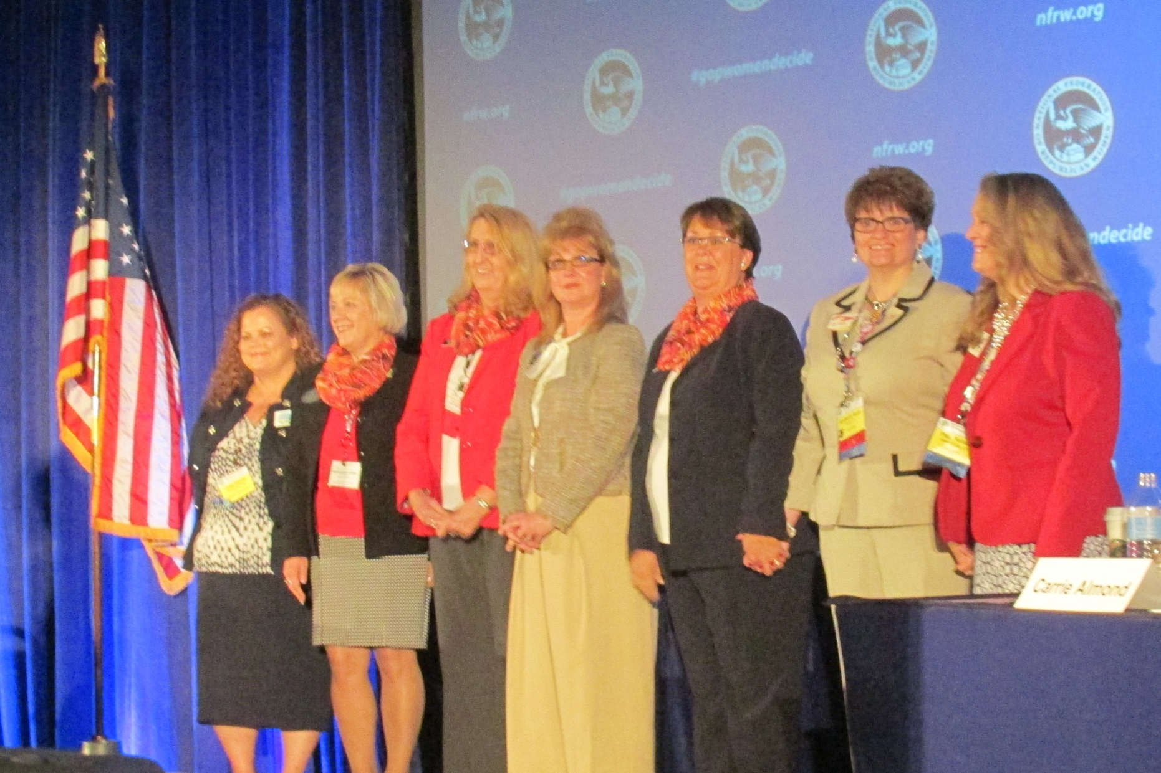
NFRW 38th Biennial Convention September 10-13th Congratulations to our new NFRW 2016-17 Elected Officers

Slide 63
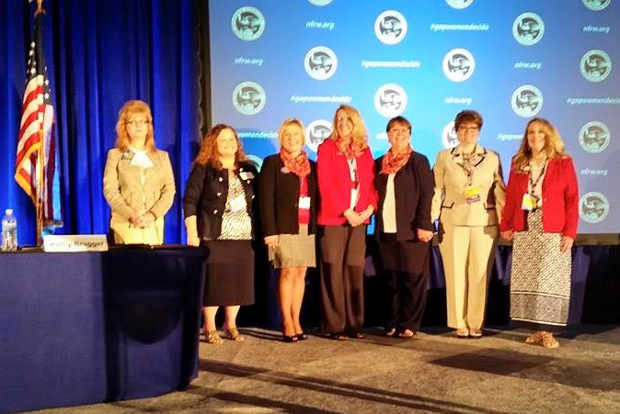
NFRW 38th Biennial Convention September 10-13th Congratulations to our new NFRW 2016-17 Elected Officers

Slide 64
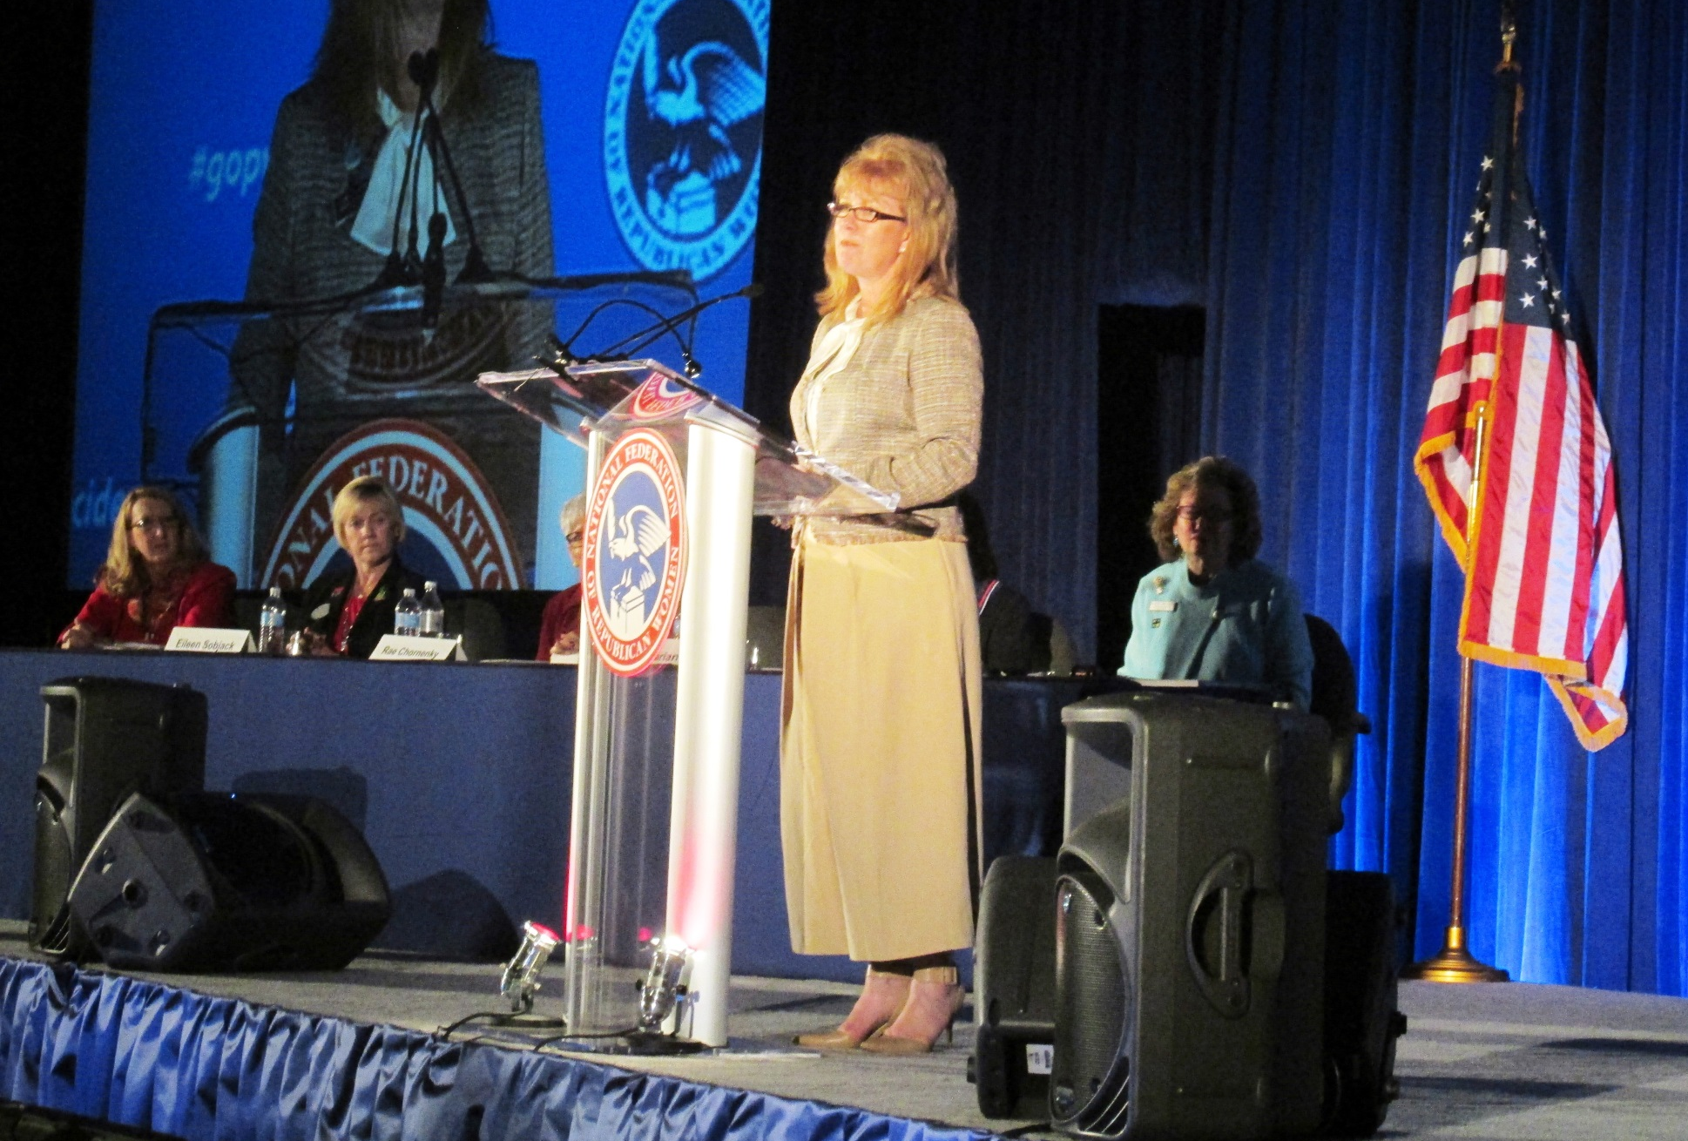
NFRW 38th Biennial Convention September 10-13th Congratulations to Carrie Almond (Missouri), NFRW President-elect

Slide 65
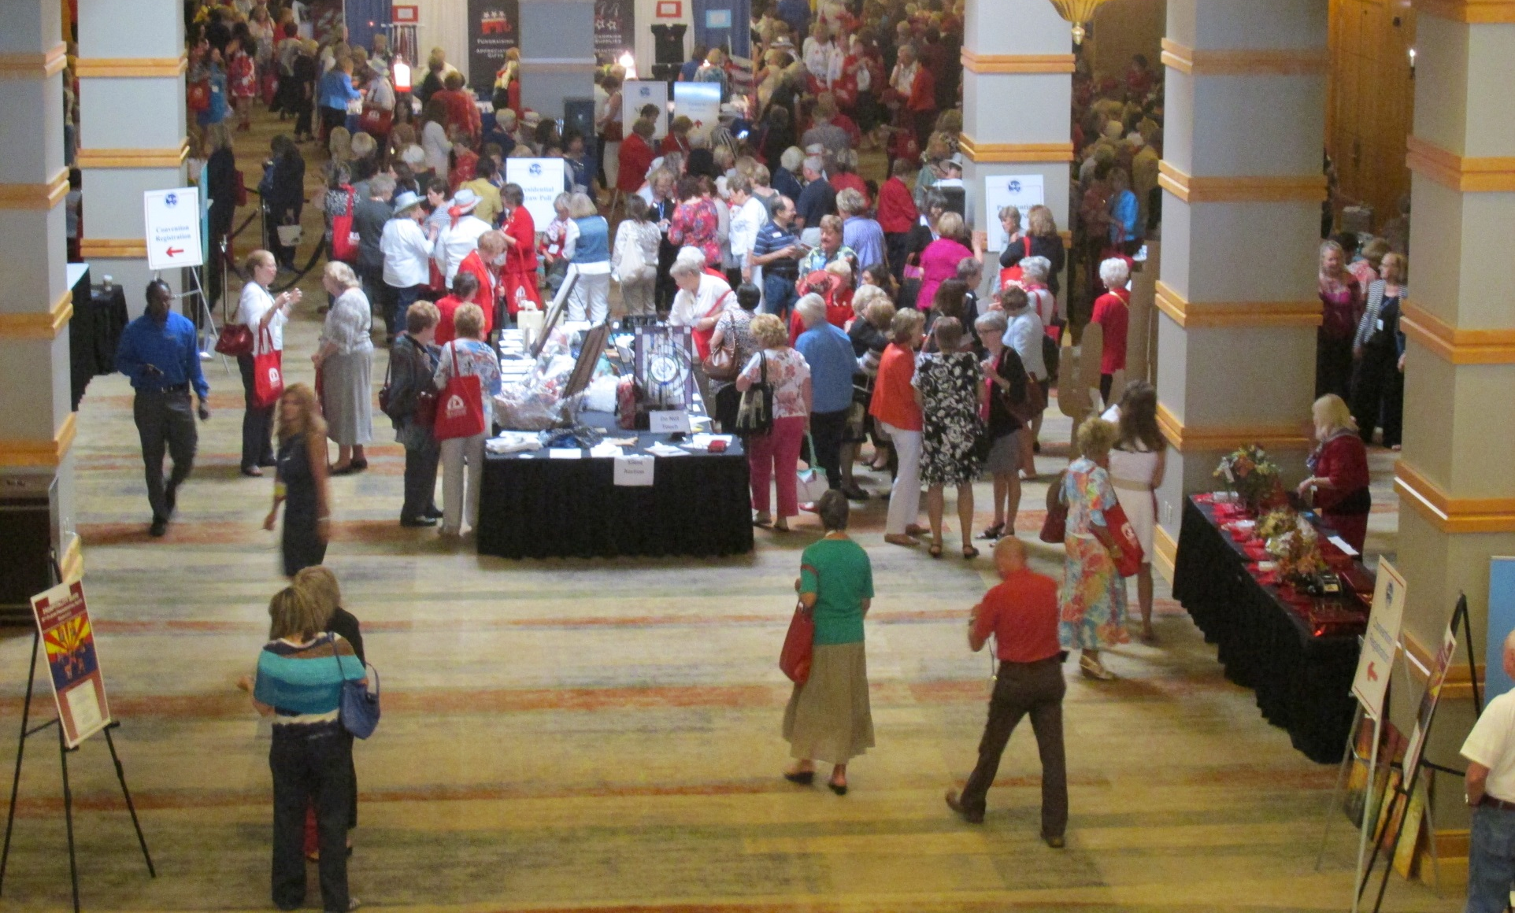
NFRW 38th Biennial Convention September 10-13th

Slide 66
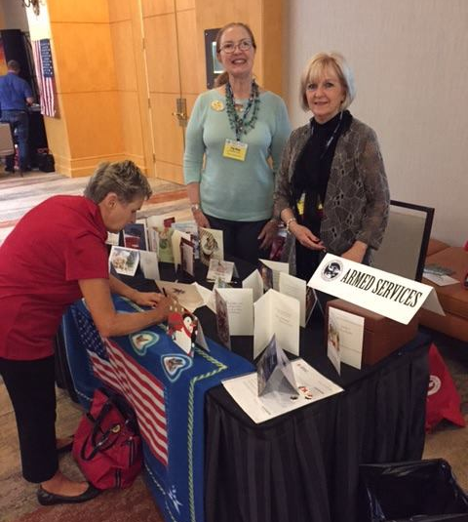
NFRW 38th Biennial Convention September 10-13th

Slide 67
NFRW 38th Biennial Convention September 10-13th

Slide 68
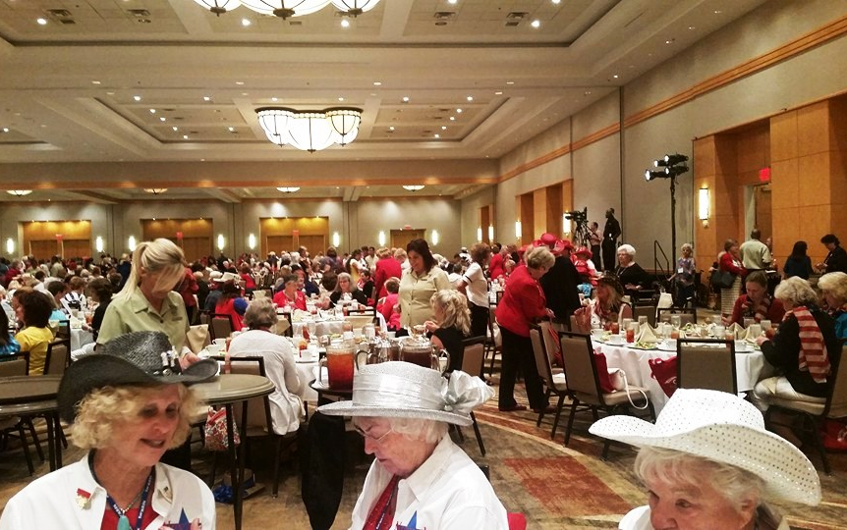
NFRW 38th Biennial Convention September 10-13th

Slide 69
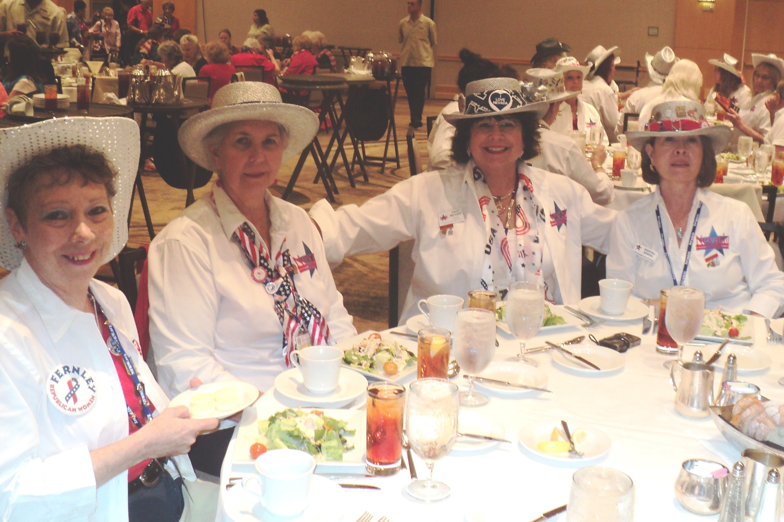
NFRW 38th Biennial Convention September 10-13th

Slide 70
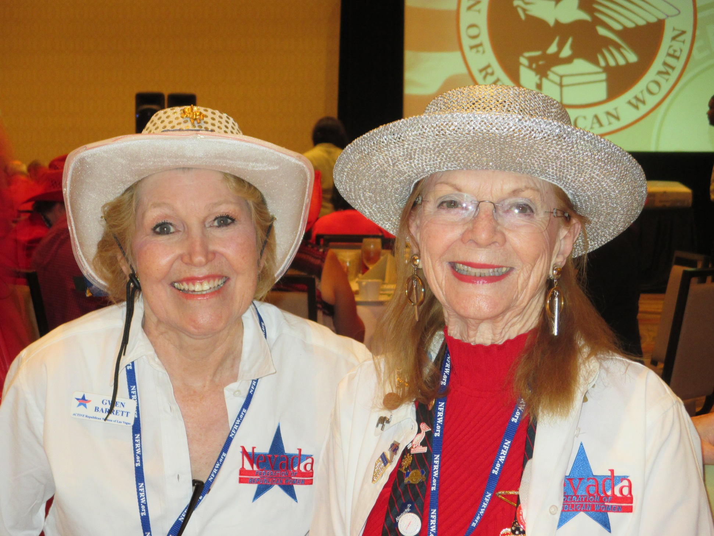
NFRW 38th Biennial Convention September 10-13th

Slide 71
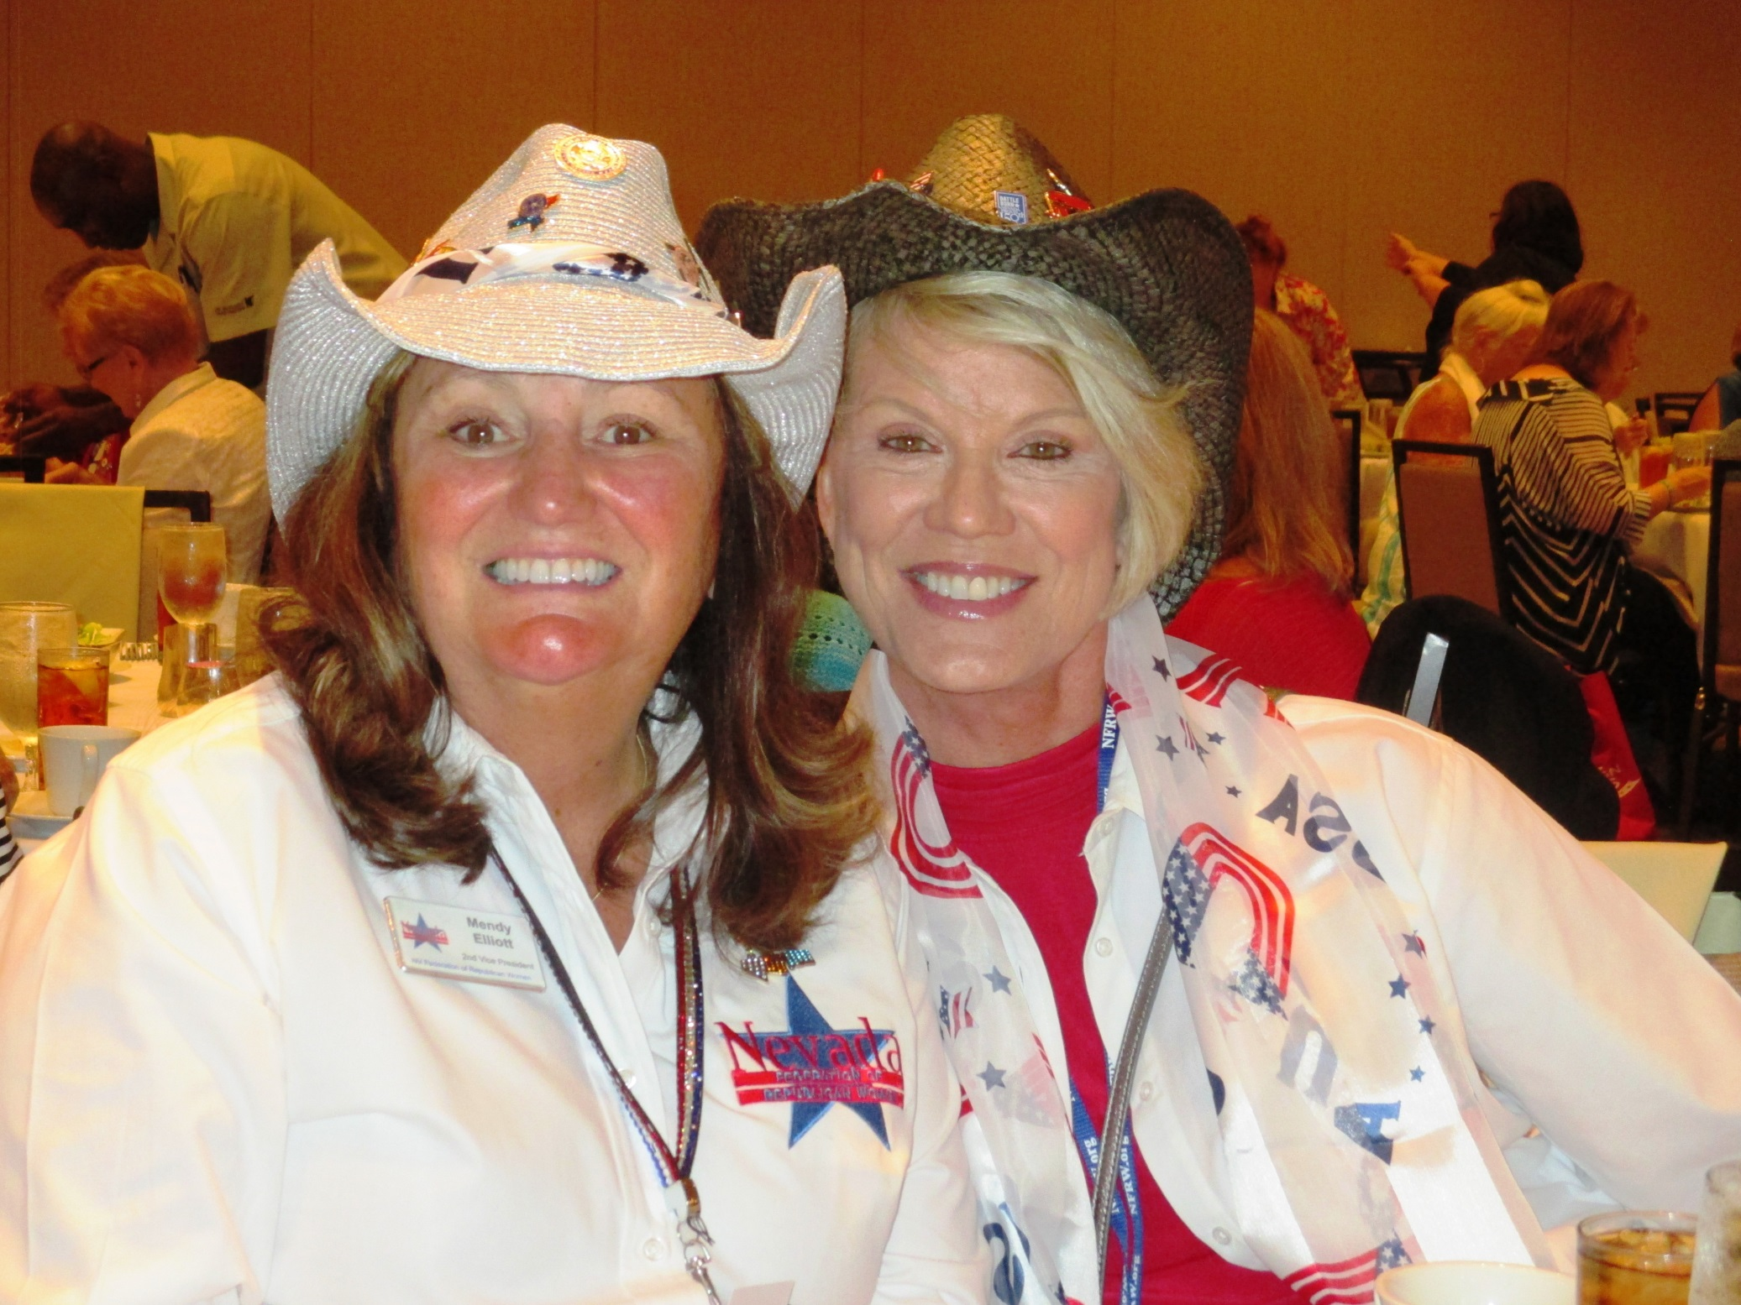
NFRW 38th Biennial Convention September 10-13th

Slide 72
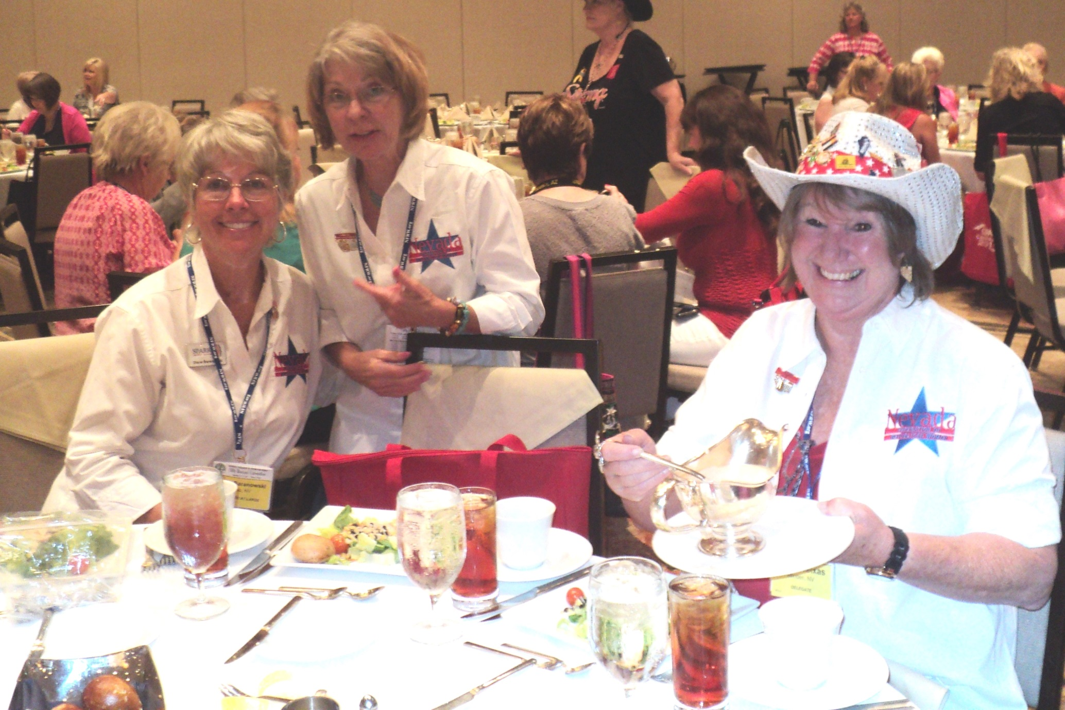
NFRW 38th Biennial Convention September 10-13th

Slide 73
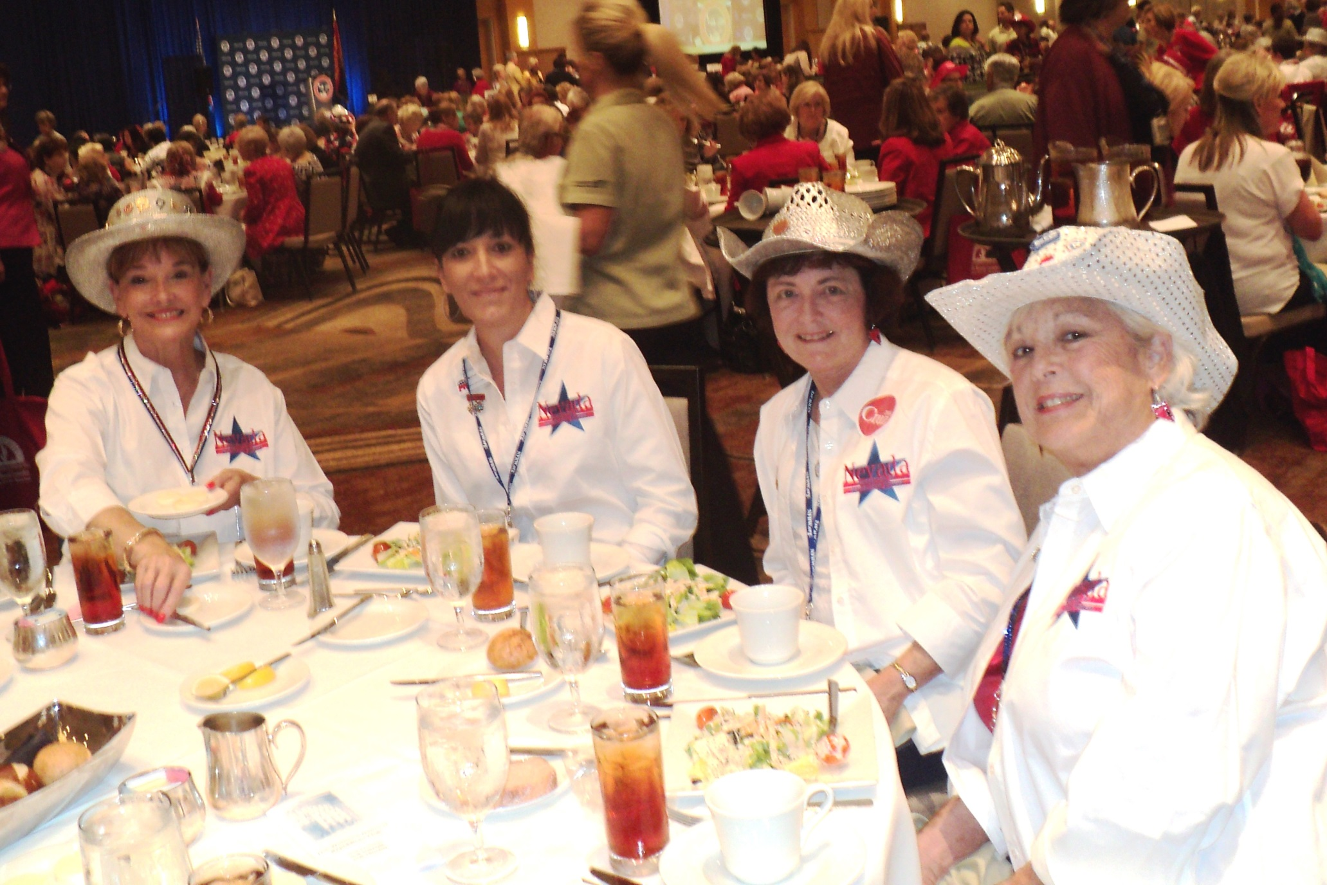
NFRW 38th Biennial Convention September 10-13th

Slide 74
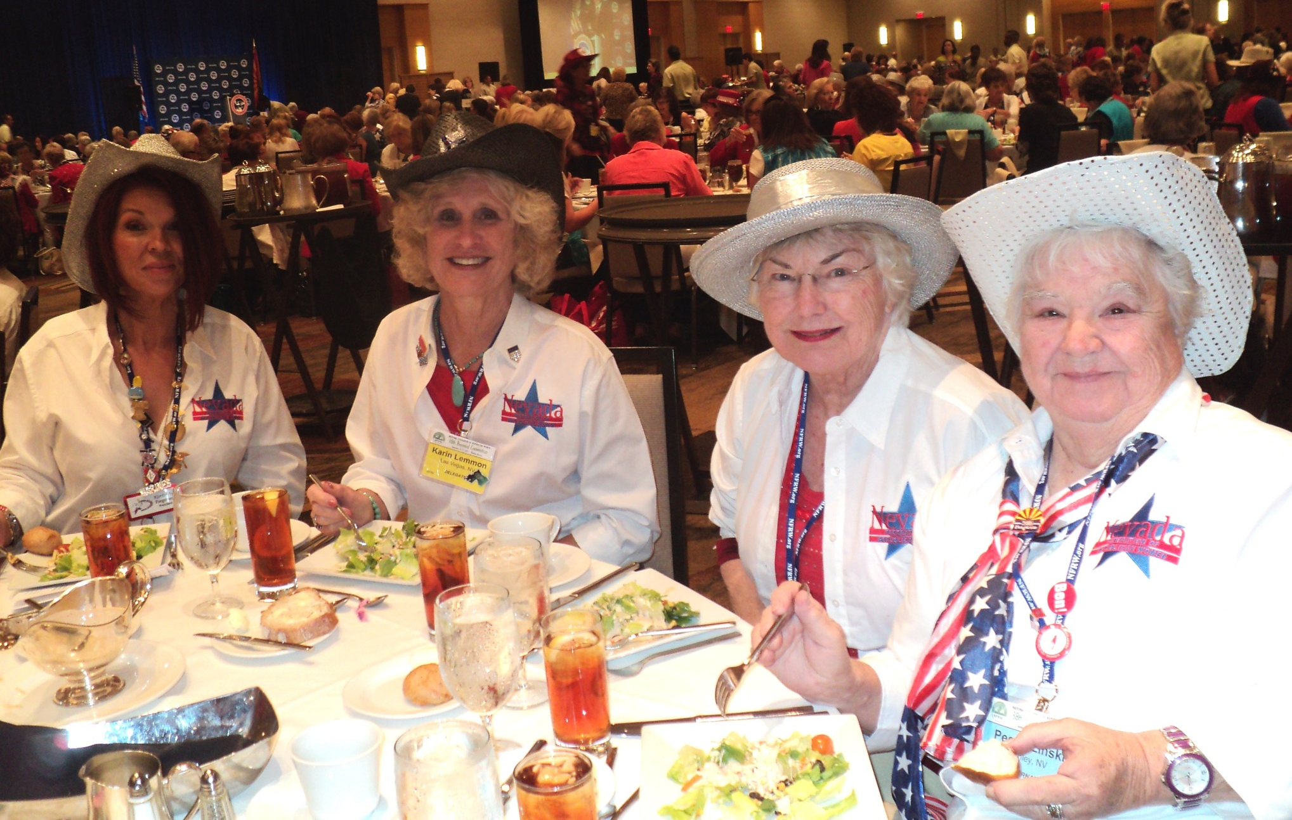
NFRW 38th Biennial Convention September 10-13th

Slide 75
NFRW 38th Biennial Convention September 10-13th

Slide 76
NFRW 38th Biennial Convention September 10-13th

Slide 77
NFRW 38th Biennial Convention September 10-13th

Slide 78
NFRW 38th Biennial Convention September 10-13th

Slide 79
NFRW 38th Biennial Convention September 10-13th

Slide 80
NFRW 38th Biennial Convention September 10-13th

Slide 81
NFRW 38th Biennial Convention September 10-13th

Slide 82
NFRW 38th Biennial Convention September 10-13th

Slide 83
NFRW 38th Biennial Convention September 10-13th

Slide 84
NFRW 38th Biennial Convention -September 12, 2015

Slide 85
NFRW 38th Biennial Convention September 10-13th

Slide 86
NFRW 38th Biennial Convention September 10-13th
…and the winner was

Slide 87
NFRW 38th Biennial Convention September 10-13th
Congratulations to New Jersey President Vanessa LaFranco, recipient of the 2015 NFRW Reagan Leadership Award. Vanessa has excelled at membership development, fundraising, communications and outreach.

Slide 88
NFRW 38th Biennial Convention September 10-13th

Slide 89
NFRW 38th Biennial Convention September 10-13th Janet Huckabee Photo by Mike Lane

Slide 90
NFRW 38th Biennial Convention September 10-13th
Cindy McCain & New Jersey Representative Chris Smith spoke about the horrors of human trafficking and their plans to stop it.

Slide 91
NFRW 38th Biennial Convention September 10-13th

Slide 92
NFRW 38th Biennial Convention September 10-13th

Slide 93
NFRW 38th Biennial Convention September 10-13th

Slide 94
NFRW 38th Biennial Convention September 10-13th

Slide 95
NFRW 38th Biennial Convention September 10-13th Senator Ted Cruz, Republican candidate, U.S. President
President-elect Carrie Almond introduces Senator Ted Cruz
Senator Ted Cruz

Slide 96
NFRW 38th Biennial Convention September 10-13th Senator Ted Cruz, Republican candidate, U.S. President

Slide 97
NFRW 38th Biennial Convention September 10-13th Senator Ted Cruz, Republican candidate, U.S. President

Slide 98
NFRW 38th Biennial Convention September 10-13th Senator Ted Cruz, Republican candidate, U.S. President

Slide 99
NFRW 38th Biennial Convention September 10-13th Senator Ted Cruz, Republican candidate, U.S. President

Slide 100
NFRW 38th Biennial Convention September 10-13th Senator Ted Cruz, Republican candidate, U.S. President

Slide 101
NFRW 38th Biennial Convention September 10-13th Senator Ted Cruz, Republican candidate, U.S. President with Nevada Delegates – Photo by Mike Lane

Slide 102
NFRW 38th Biennial Convention September 10-13th Senator Ted Cruz, Republican candidate, U.S. President

Slide 103
NFRW 38th Biennial Convention September 10-13th Senator Ted Cruz, Republican candidate, U.S. President

Slide 104
NFRW 38th Biennial Convention September 10-13th Senator Ted Cruz, Republican candidate, U.S. President

Slide 105
NFRW 38th Biennial Convention September 10-13th Nevada Delegates

Slide 106
NFRW 38th Biennial Convention September 10-13th NEVADA DELEGATES, ALTERNATES & GUESTS

Slide 107
NFRW 38th Biennial Convention September 10-13th

Slide 108
NFRW 38th Biennial Convention September 10-13th

Slide 109
NFRW 38th Biennial Convention September 10-13th

Slide 110
NFRW 38th Biennial Convention September 10-13th

Slide 111
NFRW 38th Biennial Convention September 10-13th

Slide 112
NFRW 38th Biennial Convention September 10-13th

Slide 113
NFRW 38th Biennial Convention September 10-13th

Slide 114
NFRW 38th Biennial Convention September 10-13th

Slide 115
NFRW 38th Biennial Convention September 10-13th

Slide 116
NFRW 38th Biennial Convention September 10-13th

Slide 117
NFRW 38th Biennial Convention September 10-13th

Slide 118
NFRW 38th Biennial Convention September 10-13th

Slide 119
NFRW 38th Biennial Convention September 10-13th

Slide 120
NFRW 38th Biennial Convention September 10-13th

Slide 121
NFRW 38th Biennial Convention September 10-13th

Slide 122
NFRW 38th Biennial Convention September 10-13th Announcement of 39th Biennial Convention September 14-17, 2017 Philadelphia, Pennsylvania

Slide 123
NFRW 38th Biennial Convention September 10-13th Announcement of 39th Biennial Convention September 14-17, 2017 - Philadelphia, Pennsylvania

Slide 124
NFRW 38th Biennial Convention September 10-13th Announcement of 39th Biennial Convention September 14-17, 2017 - Philadelphia, Pennsylvania

Slide 125
NFRW 38th Biennial Convention September 10-13th

Slide 126
NFRW 38th Biennial Convention September 10-13th Kellyanne Conway, President and CEO, the polling coming, inc./Woman Trend – gives the poll results!

Slide 127
NFRW 38th Biennial Convention September 10-13th Kellyanne Conway, President and CEO, the polling coming, inc./Woman Trend – gives the poll resultsl

Slide 143
NFRW 38th Biennial Convention September 10-13th
^{Turning over the gavel!}

Slide 144
NFRW 38th Biennial Convention September 10-13th

Slide 145
NFRW 38th Biennial Convention September 10-13th
Pooped!

Slide 146
NFRW 38th Biennial Convention September 10-13th
Photos provided by various members of the Nevada delegation. In addition, some photos were taken from various Facebook and website posts including the National Federation of Republican Women’s Facebook page and website.

